Slide 1
Notes:
In this video from ITFreeTraining, I will look at webcams. As the name suggests, these cameras are used primarily for use as a video camera that can connect to the internet. This video will look at what to look for in a webcam and what to do if your video camera is not supported as a webcam.

Slide 2
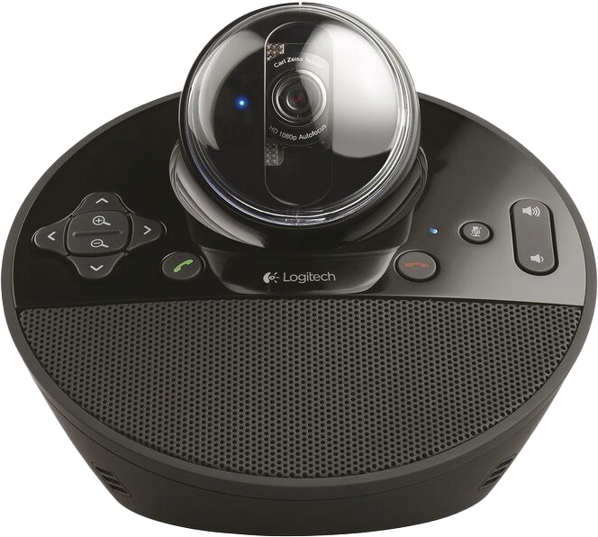
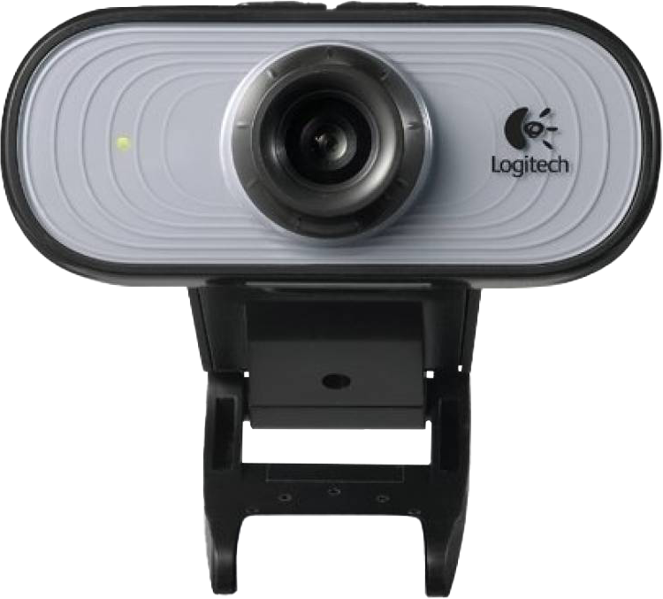
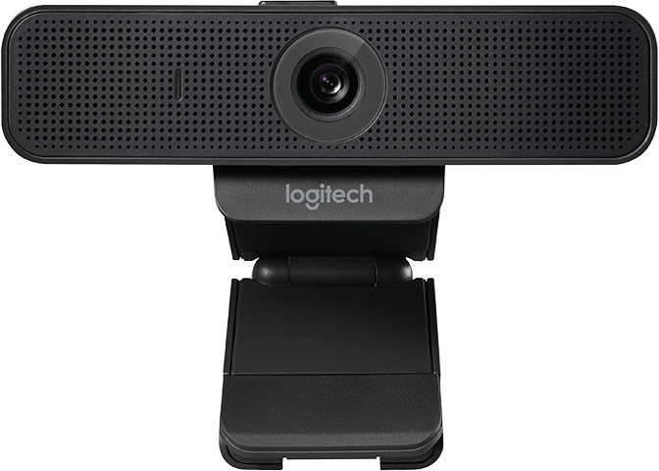
Webcams
Video cameras that stream video
Designed with video chat in mind
Basic/no microphone
Inbuilt microphone
Zoom and pan
ITFreeTraining.com
© Copyright 2023
Notes:
00:21 A Webcam is essentially a video camera designed to stream video. Unlike other video cameras, it is designed with video chat in mind. So essentially, it is designed to be used when a person is directly in front of the camera and in close proximity to the camera.
There are a lot of different webcams on the market. The most basic is a webcam that provides video only. These are pretty hard to purchase now. Even the very basic webcams nowadays have built in microphones as well as recording video. Audio quality can vary quite a lot between different Webcams; however, you can always use an external microphone or headset if the audio quality is not good enough.
On the more expensive end, you can get webcams that have more control. For example, pan and zoom functions. Although most webcams are essentially designed with video conferencing in mind, it is possible to have a webcam that is designed to be used outside. For example, if you consider a camera that is being used to monitor traffic conditions, if it is connected to the internet, it would be considered a webcam. So, to put it simply, if it is a camera designed for video conferencing or can stream video over a network or the internet then it is a webcam.
I will now have a look at the basics of how webcams work to give you an idea of what to look for.

Slide 3
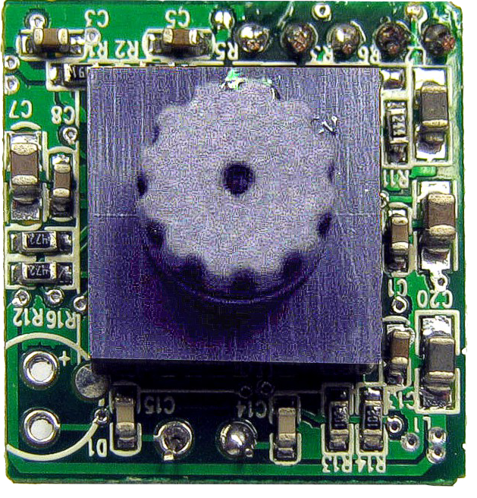
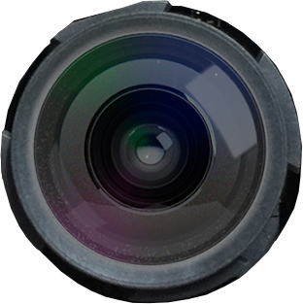
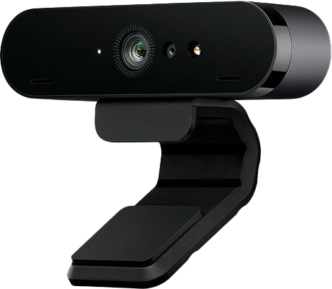
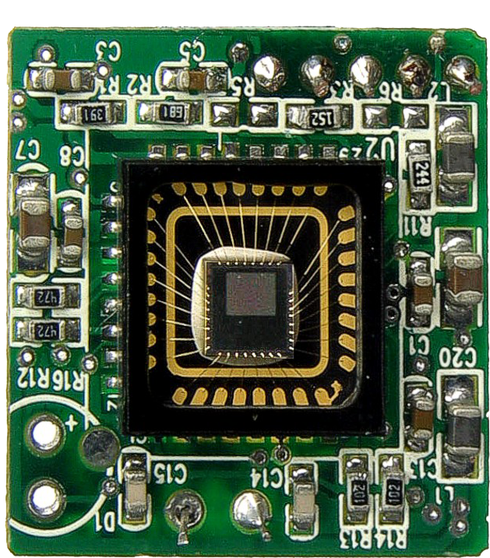
Webcam Basics
CMOS or CCD sensor
Generally use plastic lens
CCD old sensor
Cheap versions are fixed
Depth of field
Mostly CMOS
nowadays
Cover over sensor
Determines
resolution/quality
Out of
focus
In focus
Big, but fixed depth of field
Image sensor
ITFreeTraining.com
© Copyright 2023
Notes:
01:40 In order for a webcam to operate, it first needs a sensor to capture light that comes into the lens. In this example, you can see the PCB board inside the webcam. The sensor is under a plastic cover and, once removed, you can see the sensor underneath.
The sensor itself will be either a CMOS or CCD sensor. CCD is the older sensor type. Although first developed in the 70’s, it was not really a mature technology until the 90’s. The difference between CCD and CMOS is essentially the material used to make the sensor. CCD was easier to get to work, but the technology has now improved so that good CMOS sensors can be made. Nowadays you will find that most webcam sensors will be CMOS sensors. There are advantages to using either sensor, but at the end of the day a good quality sensor will perform better than a bad quality sensor.
To get an idea what kind of quality you can expect, the sensor will determine the resolution and quality the webcam supports. Looking at the resolution can be a little misleading. It is not uncommon, it actually happens more often than not, that the sensor will measure less resolution than the maximum supported resolution. To get the higher resolutions, the electronics in the device will use averaging and other upscaling techniques. When looking at webcams, the manufacturer may not release what kind of sensors the webcam uses. To get an idea, ask the salesperson to give you a demo or find some test footage on YouTube. There are plenty of people who give new webcams a test run and post videos showing their results.
For a lot of webcams, you will find that they generally use a plastic lens. Plastic lenses are cheap to make. You will find that they are used in a lot of mobile devices. Glass lenses make a difference, but with a good sensor, a plastic lens will also give you good results. Unless you start spending some big money, you most likely will have a plastic lens on the camera.
The cheaper cameras will have a plastic lens that is fixed in place, that don’t have optical zoom. When I say cheap, I mean very cheap webcams. These are the ones you find in the bargain bin or very, very cheap on ebay. Nowadays, at any decent store, the cheapest webcam should not use a basic plastic lens.
On very old webcams, you may find that they have a focusing ring to move the lens in and out, which will change the focus of the webcam rather than having an internal motor for automatic focus. Nowadays, generally webcams all have automatic focus. The more expensive webcams will also have the ability to zoom in and out as well.
If you have a basic fixed plastic lens, this means the lens cannot move and thus the focus of the webcam will not be able to change. Not having to worry about focusing also means less electronics in the webcam making it cheaper to make. To understand how one can get away without being able to change the focus, let’s have a look at the concept of depth of field.
Depth of field essentially means this. Consider that you have a webcam. A fixed lens webcam will have an area in front of it that will be in focus. In the case of cheap webcams, the depth of field is big, but fixed. Essentially, they attempt to get the maximum depth of field as close to infinite as they can.
This essentially means that if you put something too close to the webcam it will be out of focus. This is generally not a problem as you generally don’t put items very close to the webcam. If you start moving away from the webcam, it should be in focus. Once you get outside of this range, it will start to become out of focus.
Keep in mind that devices like webcams and mobile devices create a very large depth of field. So, even if you have mountains in the background, they should not look out of focus; however, they won’t look sharp. Think of it like this, depth of field is a range where items in the middle of the field are the sharpest. If the camera allows it, this range can be moved so different items are in focus. To get the best results, the subject should be in the middle of the depth of field. Webcams tend to focus on the biggest item directly in front of the webcam, which will generally be the subject. A good webcam should also be adjusting the depth of field to the subject to get good results.
This may not sound like a big concern, but consider you want to show someone something on a webcam, for example a document. When this occurs, you want the webcam to be able to change its focus so, when the document is close to the webcam, it can be seen. The very ,very cheapest webcams won’t be able to do this; however, you don’t have to pay that much to get a webcam that will.
So now that we have a basic understanding of how webcams work, what is the disadvantage of using them compared with a regular camera.

Slide 4
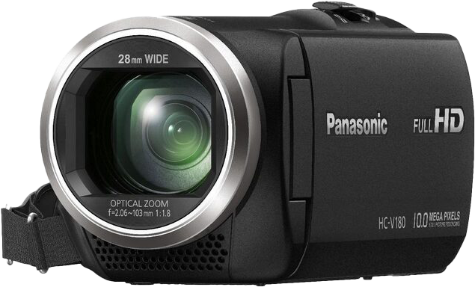
Webcam vs Video Camera
Made for specific purpose
More general use
Cheaper to make
More features/Higher cost
Big depth of field
Variable depth of field
More light for good results
Works better in low light
ITFreeTraining.com
© Copyright 2023
Notes:
06:54 The point to remember with a webcam is that it is designed with a specific purpose in mind. By contrast, a video camera is made for more general use. So, generally speaking, webcams will be cheaper to make than a video camera. This is because the additional features in a video camera increase the manufacturing costs.
Video cameras tend to have features like optical zoom. The more expensive webcams will have more features such as optical zoom; however, they are still designed with the specific purpose of being a webcam.
Webcams are also designed with a big depth of field, whereas, generally, video cameras are designed with a variable depth of field. Unless the video camera is very cheap, it will have features like an adjustable iris. This affects how much light reaches the sensor in the camera. Webcams may not have this feature. At least, the cheap ones won’t.
In the case of a webcam, having a fixed iris means the iris needs to be quite small in diameter. I won’t go into the science of this, but essentially you need a small iris in order to get a big depth of field. A small iris means less light gets in, so to get good results, you need more light.
This is generally not a problem since webcams are generally used inside. This means that you can control the light in the room. It is pretty simple to add additional lights if needed. In contrast, since a video camera can generally change things like the Iris and other settings, video cameras work better in low light.
If you are looking at video conferencing or video chat, a webcam should meet your needs. If you are using it in a conference room, it may be worth looking at paying the extra money for a webcam that has pan and zoom functions. A lot of video conferencing software will be able to access these functions.
So, the next point to consider is, would you want to use a video camera rather than a webcam. There are a lot of digital cameras out there that have video functions. Would you want to consider using one of them?

Slide 5
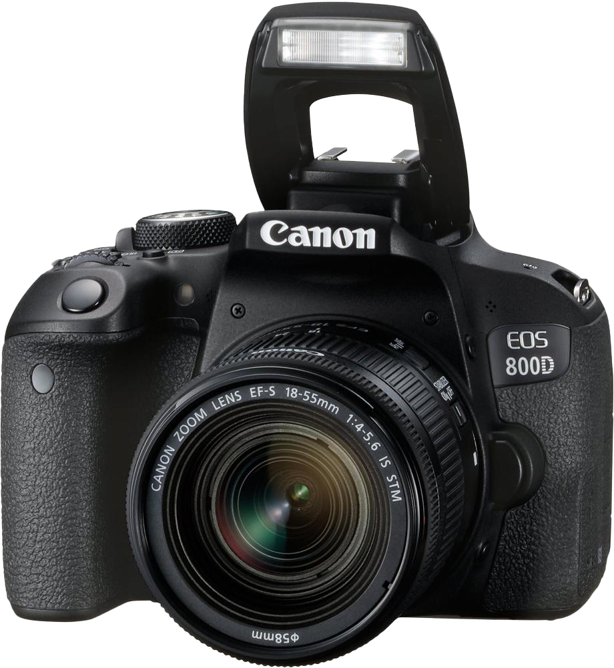
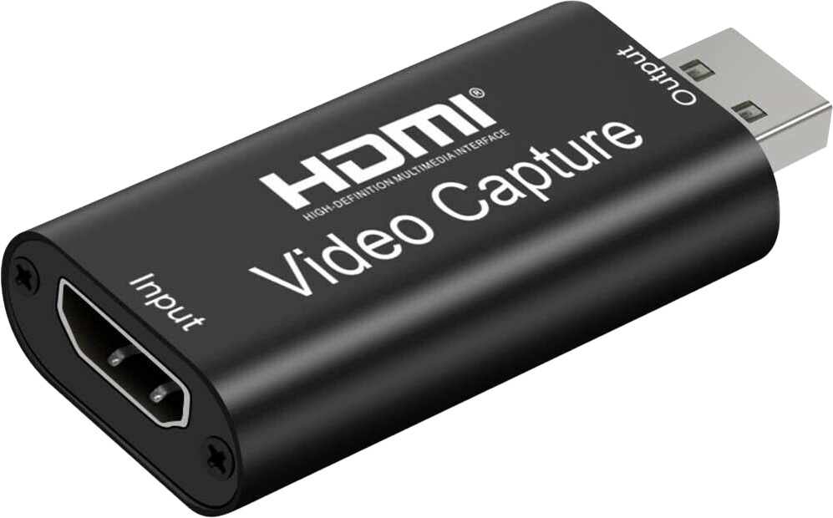
Webcam Alternatives
HDMI to Webcam
converter
Still camera may not support video
Better control of focus
Output will
be what camera
outputs
May require additional software
Bulky compared with webcam
ITFreeTraining.com
© Copyright 2023
Notes:
09:05 If you have already spent a lot on a video camera or digital camera, you may want to consider using these as a webcam. A camera you spent thousands of dollars on should give you better results, in theory anyway.
Let’s consider that you have either a digital camera or a video camera you want to use as a webcam. The first thing to check is if it supports being used as a webcam. Although pretty common nowadays, not all still cameras will have this feature. If they do support this feature, also check what resolution they export at. They may not export at the full resolution of the camera due to limitations of bandwidth from the camera.
Using cameras like this, assuming they are of good quality, you should be able to get some good results. For example, a good quality camera will give you better control of focus. The cheaper webcams and cameras use a fixed large depth of field or have limited ability to change it. This essentially is designed to allow it to give good results in a large number of situations. This makes them essentially point and shoot; however, having them fixed like this means that you don’t have a lot of control of what you are shooting. For example, if you watch a movie, you will notice that often the actor in the shot will be in focus while the background is out of focus. Film makers do this to make the actor look sharp and in focus, thus bringing attention to the actor and blurring out what is less important like the background.
If you are using a webcam at home or in a conference room, this level of control probably won’t be of importance to you. If you are using green screens, then you may want the extra level of control. A green or blue screen is placed behind the actor. This color is then removed by software or hardware and can be replaced by your own background.
If you are using a green screen, one little trick is to keep the actor in focus and have the green screen out of focus. This gives better results when removing the green screen and replacing it with your own background. To do tricks like this, you need equipment with manual controls which generally professional cameras and video cameras will have.
Remember, that webcams are designed to be used as webcams. So essentially, they are plug and play. By contrast, if you start using devices that were not designed for the primary purpose of being a webcam, they may require additional software in order to work. This means they may not be usable in your voice chat software or conferencing software, by default, and may require additional software or workarounds.
To get around this, a simple solution is to purchase a device like an HDMI to webcam converter. Most devices will have an HDMI output plug. These devices allow the computer to see the device as a webcam. In some cases, the HDMI output may output a lower resolution than the camera captures. HDMI converters are pretty cheap to buy and a lot easier than installing additional software. However, keep in mind the output will be what the camera outputs. If your camera is outputting information on the screen such as the battery level and other information, this will be transferred to the computer. With some cameras you will be able to switch this information off, some you will not. So, if you decide to purchase an expensive camera and want to use that as a webcam as well, do your research first and make sure that it will work the way you want it to. If you purchase a good quality webcam, you may not have as much control over the output, but at least it will work with only a small amount of effort.
The last point to consider is that still cameras and video cameras are bulky compared with webcams. Installing a webcam may just involve hanging it on the top of your monitor. However, you may need a tripod or other mounting device to connect a camera. These devices will often require additional power, whereas a webcam will normally just run off a USB cable.
If you decide to use a dedicated webcam, you should be able to get it up and running with minimal amount of effort. Using a still camera or a video camera may give you better results, but unless it is designed to run as a webcam it could be more trouble than it is worth to get it running. Make sure you check the packaging before purchase, and it says that it will work as a webcam.
Software support is getting better and better. It is possible nowadays to get software to run on your mobile device or tablet to get it to work as a webcam. If you just want to give it a go and don’t want to spend any money, you may have a mobile device already that you can use as a webcam.
Now that we have had a look at what you may check for, let’s consider what you need to think about in terms of privacy and security.

Slide 6
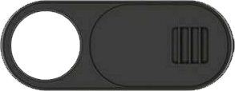
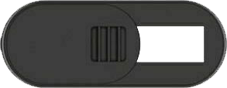
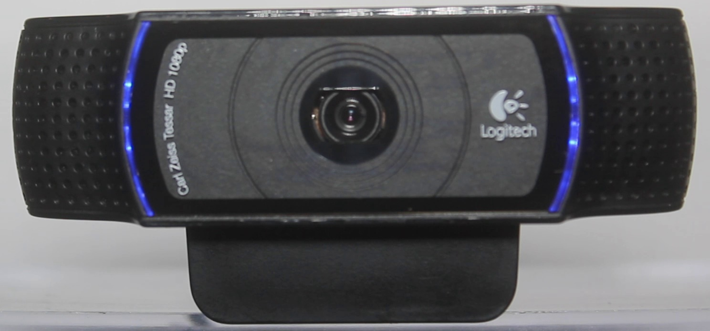
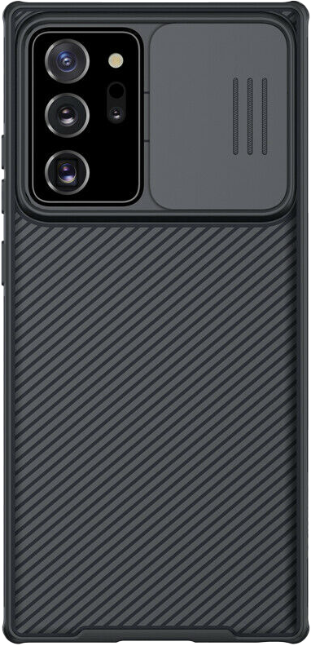
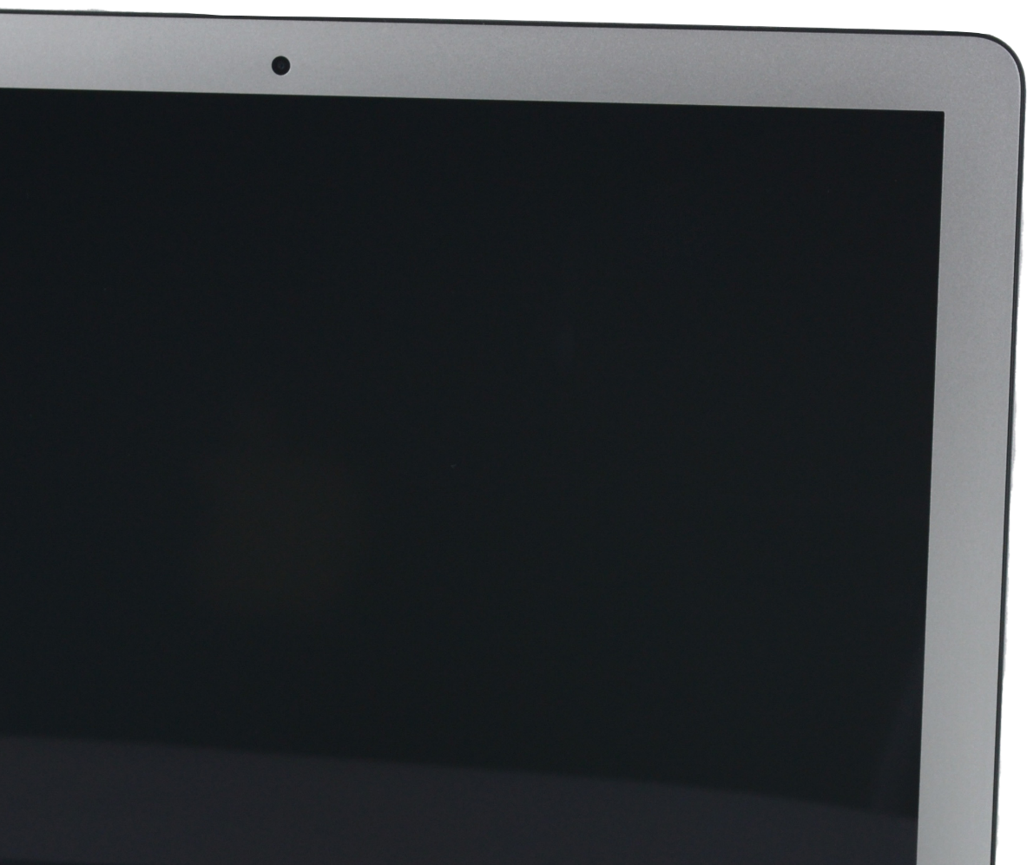
Camera Privacy and Security
Camfecting: Hacking a camera remotely
Webcam Privacy Slider
Webcam with
light to indicate
in use
Phone case with
sliding Camshield
ITFreeTraining.com
ITFreeTraining.com
© Copyright 2023
Notes:
13:50 Since a webcam is able to connect to the network, it essentially can be remotely controlled. Connecting to a webcam without permission is called “Camfecting” or essentially hacking into the camera remotely.
Good security, such as installing the latest updates and installing a firewall will help prevent this happening, but can’t guarantee that it won’t happen. To get around this problem, there are many places that sell webcam privacy sliders. These are essentially a little slider that either blocks or unblocks the webcam.
In the case of this laptop, there is an in-built webcam. The privacy slider is either stuck on or in some cases a magnet is used. Having a slider like this means that even if the laptop is hacked, while the camera is blocked, the attacker won’t be able to see anything using the webcam.
If you are never planning on using the webcam in your laptop, you can also place some tape over the webcam to block it. These sliders can also be used on mobile devices and tablets. However, in the case of newer mobile devices, they may have a number of cameras making it difficult to apply a slider like these. In this case, you should consider purchasing a case with a slider built in.
In some cases, your webcam may have a light in it that will light up when the webcam is used. In this example, when the webcam is activated the blue light around the lens will light up. The webcam is built in such a way that when the camera is powered, the light will come on with it. Since it is hardwired like this, it is not possible to switch the camera on without switching the light on.
Hopefully, if someone hacks into your webcam you will notice the light coming on. If you are concerned, you can always turn the webcam away from you when you’re not using it, or unplug it. Unfortunately, webcams are hacked into remotely every day. Generally, the most common attack on webcams are ones where they are still using the default usernames and passwords or simple passwords. There are websites out there that will provide lists of hacked webcams. If you are worried about this, make sure your security is up to date and, where appropriate, purchase a webcam slider or other device to block the webcam when it is not in use.

Slide 7
3D Webcam
Can record video in 3D
Other party will need VR or 3D TV
3D scanning
Gesture Tracking
Facial analysis and recognition
ITFreeTraining.com
© Copyright 2023
Notes:
16:07 The last topic that I will look at is 3D webcams. These webcams have two cameras that record slightly different views of the world that can be used to create a video that looks 3D like. The webcam may also have additional sensors for depth perception.
The webcam can record in 3D. However, in order for the other party to view it in 3D, they will need a virtual reality headset or a 3D TV. 3D webcams have not really taken off because, generally, there is little perceived benefit of video conferencing or video chat for the extra hassle of having to use a VR headset or 3D TV.
3D Webcams do, however, allow for 3D scanning. This essentially means that it can pick up movement and objects in 3D space, for example, gesture tracking. So essentially, you could make a movement in 3D space and this could be translated into an instruction for the computer. This is something that looks good in the movies, but in the real world is not used that much because it is generally easier to use a mouse and keyboard.
Something that is starting to get used a lot more is facial analysis and facial recognition. Not so much on computers as yet, however, on mobile devices you are starting to see it more and more. Mobile devices are starting to use 3D for facial recognition as a way of automatically unlocking the device by the user looking at the camera. 3D gives better security as older facial recognition could be bypassed by holding a printed picture of the person in front of the camera.
We have not seen this technology used in laptops, except in a few cases. If it is proven to be successful in mobile devices, we may see this change in the future and become more
commonplace in laptops.

Slide 8
Subscribe
Next video
Video content: https://ITFreeTraining.com/ap/2c70
© Copyright 2023
Notes:
17:59 That concludes this video from ITFreeTraining on webcams. Hopefully we helped you understand them better and given you a better idea of what to purchase. Until the next video from us, I would like to thank you for watching.
References
“The Official CompTIA A+ Core Study Guide (Exam 220-1001)” Chapter X Section 5 Paragraph 230 - 239
“CompTIA A+ Certification exam guide. Tenth edition” Pages 416 – 417
“Webcam” https://en.wikipedia.org/wiki/Webcam
“CCD versus CMOS: Which is Better?” https://diffractionlimited.com/ccd-versus-cmos-better
“Picture: Sweex USB webcam PCB with without lens close up.jpg” https://en.wikipedia.org/wiki/File:Sweex_USB_webcam_PCB_with_without_lens_close_up.jpg
“Picture: Cat” https://unsplash.com/photos/_ir1D49PRqM
“Picture: Tin Can” https://unsplash.com/photos/xqlR_7vNMfs
“Picture: Tree” https://unsplash.com/photos/qPRF2l27Lhg
“Picture: Laptop” https://en.wikipedia.org/wiki/Laptop#/media/File:Macbook_Air.jpg
Credits
Trainer: Austin Mason http://ITFreeTraining.com
Voice Talent: HP Lewis http://hplewis.com
Quality Assurance: Brett Batson http://www.pbb-proofreading.uk

