Slide 1
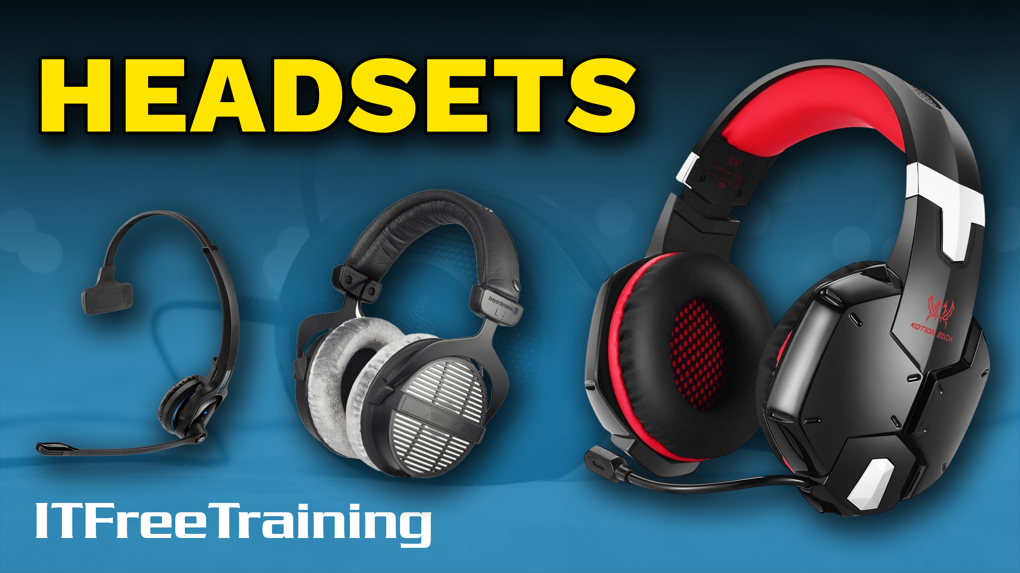
Notes:
In this video from ITFreeTraining, I will look at headsets. Headsets offer an alternative to speakers and in some cases come with a microphone. This video will look at what to look for in a headset depending on what your needs are.

Slide 2
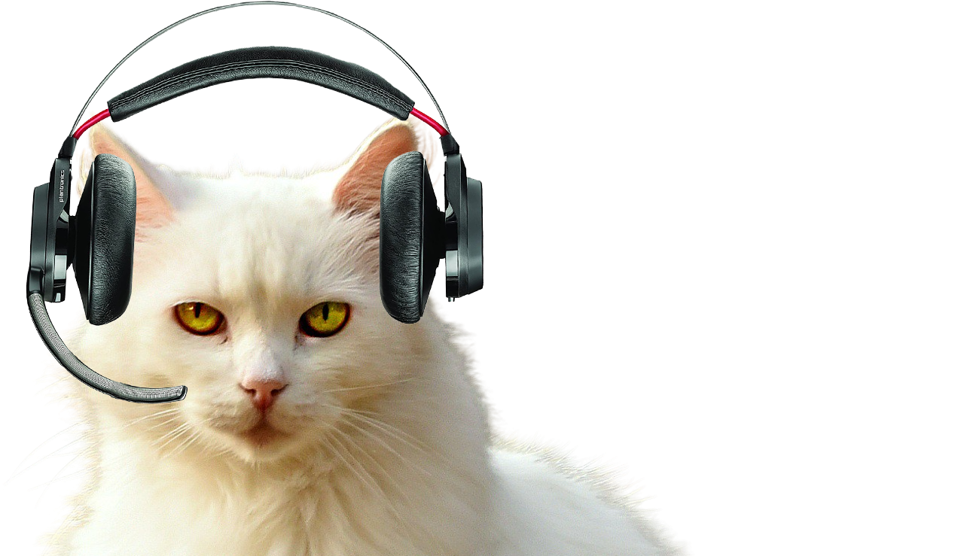
Headset Types
Many different types and designs
ITFreeTraining.com
© Copyright 2023
Notes:
00:14 There are many different types of headsets on the market. These include on-ear, over-ear, open-back, closed-back, in-ear, surround sound and noise-cancelling headphones just to name a few. Your choice will depend on your needs. So, let’s have a look at the different types of headsets that are available.

Slide 3
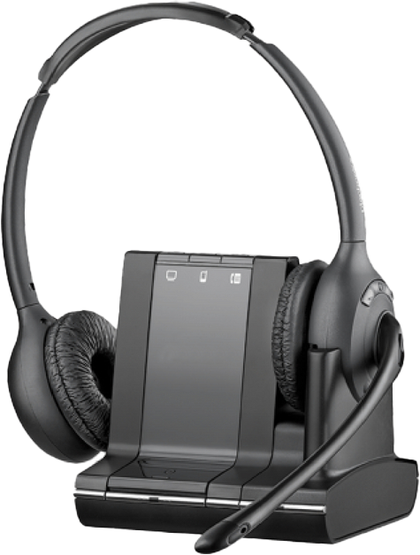
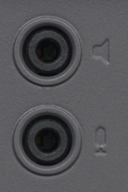
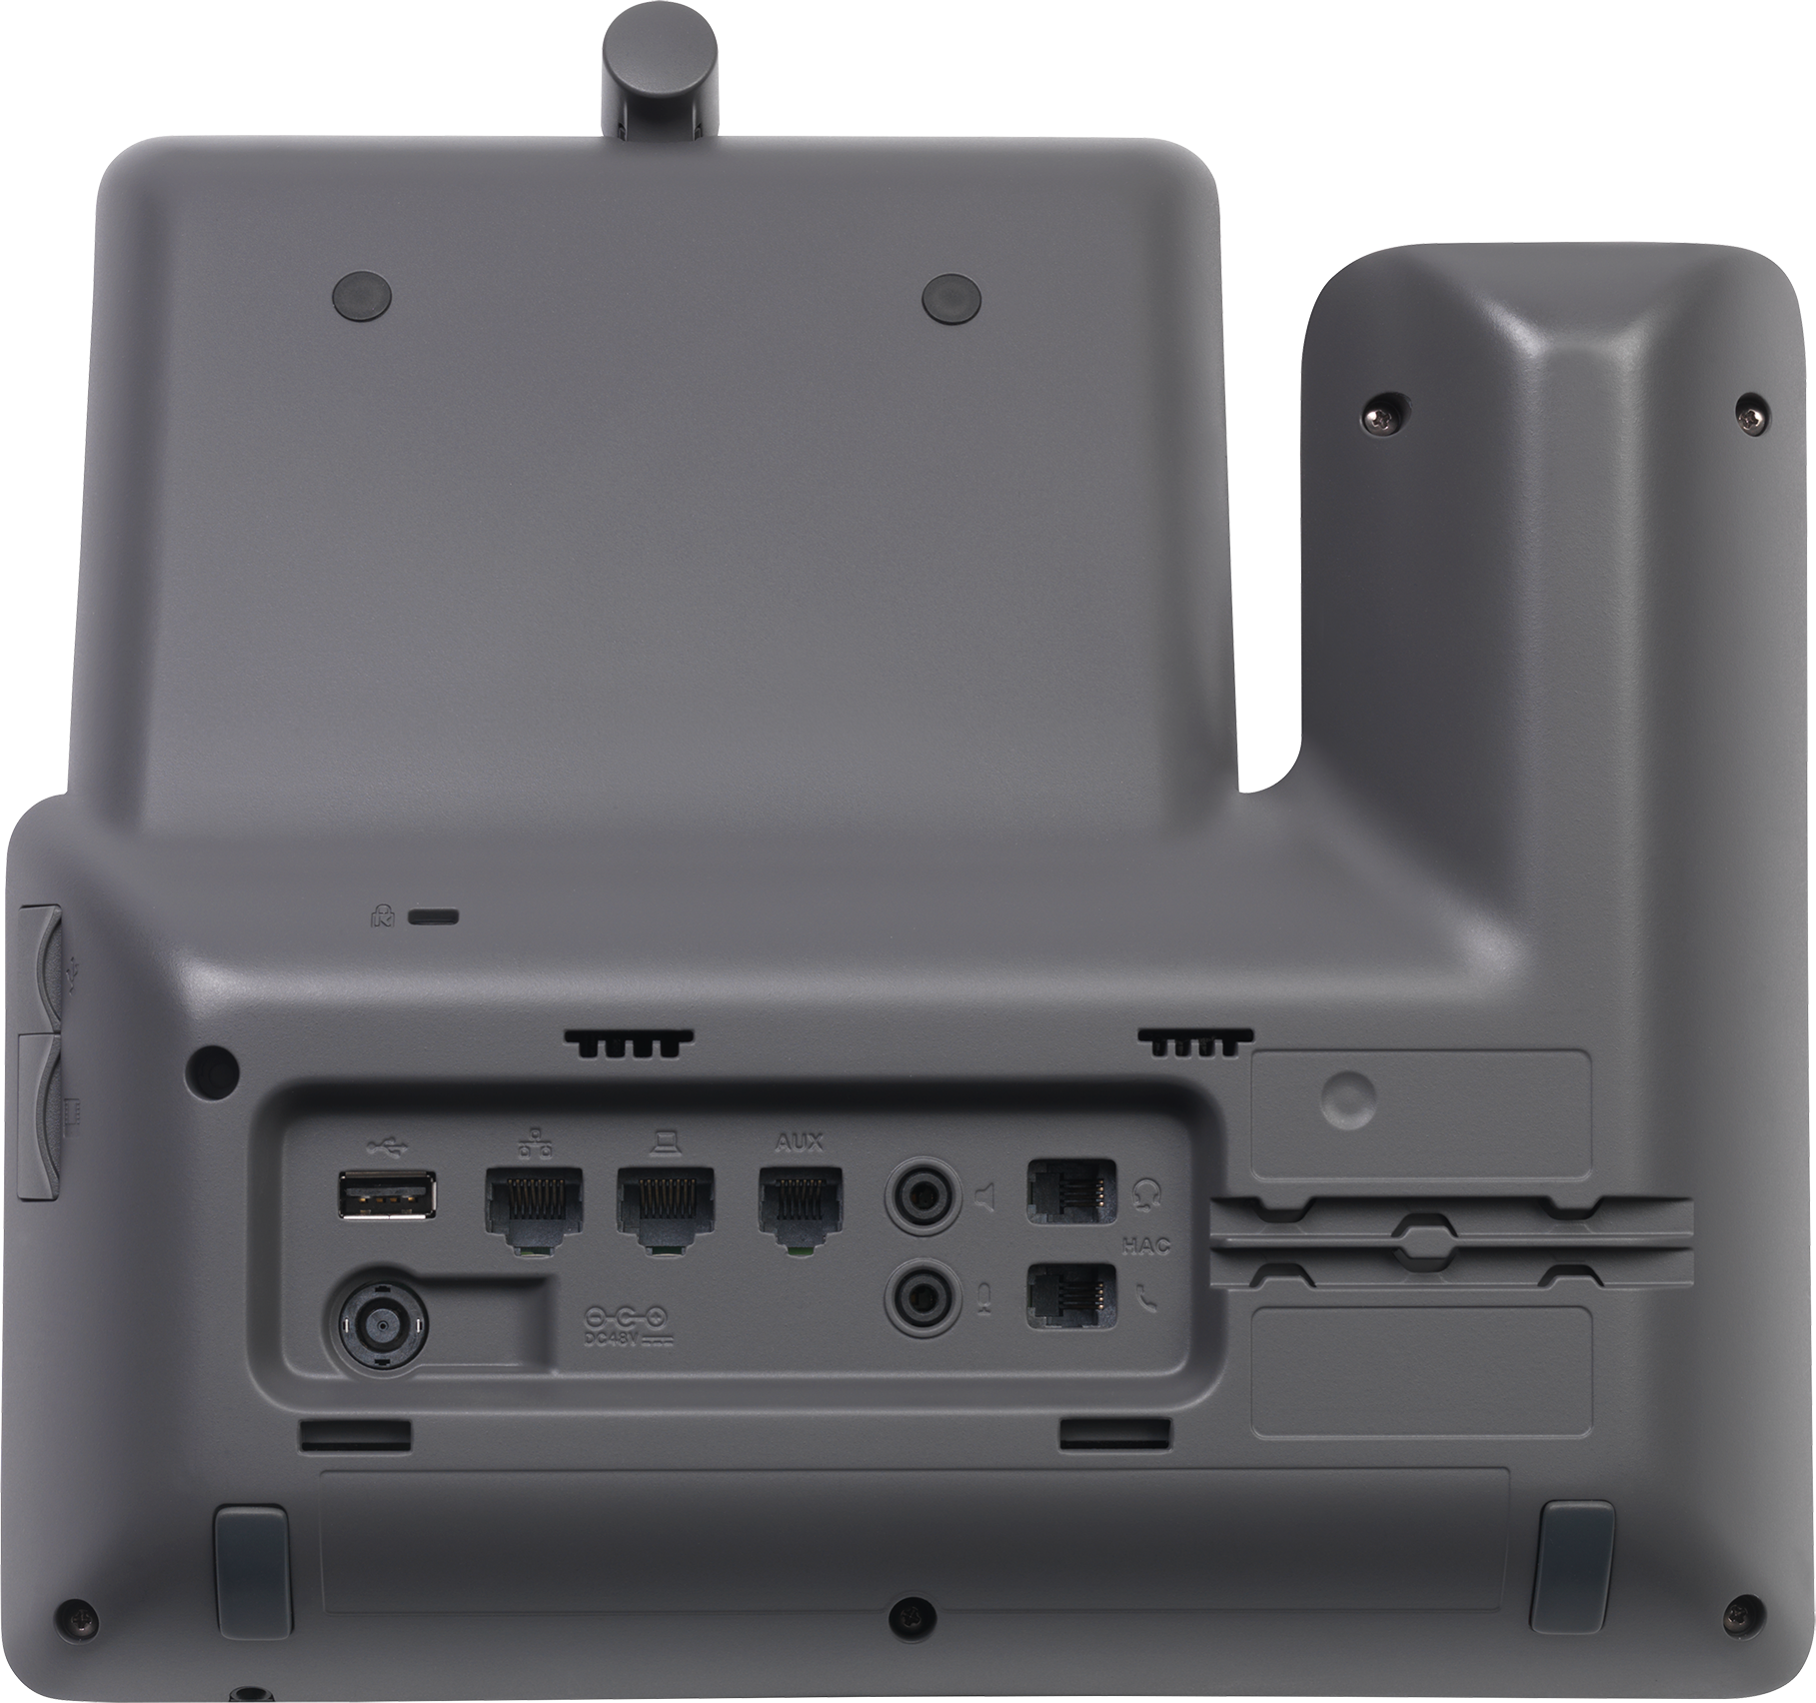
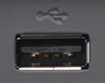
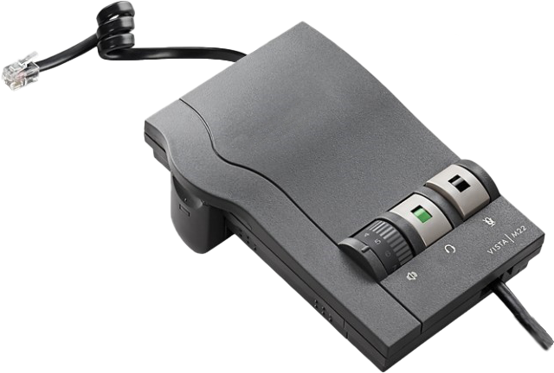
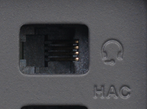
Phone Headset
Check for compatibility
3.5mm plugs
Mic/Speakers
USB headset
Connection to
computer
Base for headset to plug into
May need to unplug phone headset
ITFreeTraining.com
© Copyright 2023
Notes:
00:36 The first thing to consider is what is the primary use of the headset. One common use is to connect a headset to a telephone. These are commonplace in call centers. If you spend a lot of the day on the telephone in front of a computer, you should consider getting a phone headset.
Before purchasing a headset, check that the headset is compatible with your telephone. Older telephones and cheaper telephones will have fewer connections. In this example, this telephone has a lot of connections, but don’t expect this to always be the case.
Modern telephones may include a USB connection. Depending on the telephone, this may support a USB headset or a connection to a computer. If you decide to use this option, make sure the telephone supports the USB device that you intend to use.
Older style headsets may have a 3.5mm plug. These may have a single plug or two plugs, one for microphone and one for speaker. Not all telephones will have these.
The next connection is an RJ connection. This is a very common connection for telephones to use. Many headsets will be designed to plug into this connector. The headset will generally have a base station that connects into this connector.
In the case of this telephone there are two RJ connectors. This means you can use both your standard telephone handset that came with the telephone and an external phone headset. If your telephone does not have two connectors, you may need to unplug your phone handset in order to use a headset.
This covers the basics of telephone headsets, let’s now look at what sort of headsets you may consider purchasing.

Slide 4
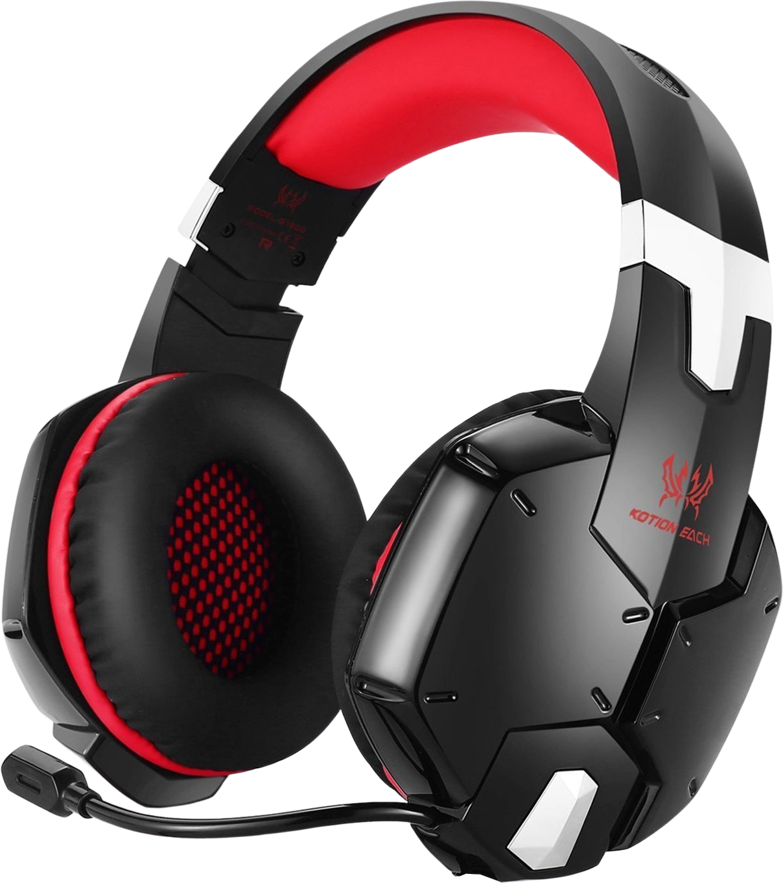
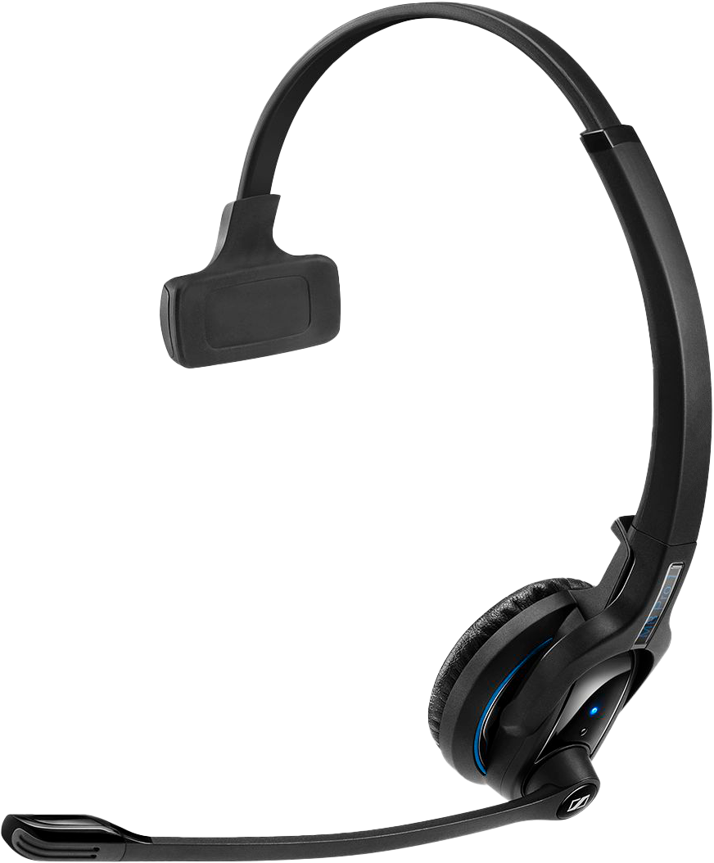
Phone Headset/Headphones
Designed for voice/office
Generally mono. No stereo sound
May have noise cancelling
Will always have a microphone
Stereo sound
May include a microphone
Designed for voice/music/FX
May not work with telephone
ITFreeTraining.com
© Copyright 2023
Notes:
02:28 Your requirements for what you want from a headset will play a big factor in the type of headset that you will purchase. If you are purchasing a headset for a telephone, these headsets are designed primarily for voice and are used in the office. For this reason, they are generally mono and thus don’t support stereo sound. In a lot of cases, they will just have one speaker.
Since these headsets are used in the office or a call center, they may include noise cancelling. Noise cancelling works by the headset recording external ambient noises. These ambient noises are mixed with the output of the headphones, however it is done out of phase. To understand how this works, consider that you have a wave. If you wanted to reduce the strength of the wave you could mix another wave that is the opposite of the first wave. For example, if the peak of a wave is combined with the trough of another wave of the same strength, they will cancel each other out.
In theory it should work well, in practice maybe not so well. Noise-cancelling headphones will effectively reduce the amount of noise the person wearing the headphones will hear. It is very difficult to create a wave out of phase to exactly match what the user is hearing. If the wave is too strong it will distort the audio output, if the wave is too weak you will hear more background noise. The end result, noise cancelling will reduce the amount of noise the person hears but not eliminate it. More on this later in the video.
Phone headsets like these will always include a microphone since they are designed to be used with a telephone.
The next headset I will look at are those not specifically designed for use with a telephone headset, however could be used for that purpose. These headsets are often referred to as headphones. These headsets will generally support stereo sound; although it is possible to create headphones that only support mono, it is more common that they support stereo sound than not. Unlike a headset designed for a telephone, the headset may or may not include a microphone.
These headsets are also primarily designed for voice, music and sound effects. Phone headsets are designed with the primary purpose for listening to voice. You will be able to hear music on them, such as on-hold music, however the quality may not be as good as a headset designed with this purpose in mind. The point to take away from here is, your needs will determine what sort of headset is best for you.
Given these headsets or headphones are designed with a different purpose in mind, they may not work with your telephone. Phone headsets are often designed with particular telephones in mind, where headphones are designed to be general purpose.
There are also design differences in headsets which will affect how they work. Let’s have a look at some of these.

Slide 5
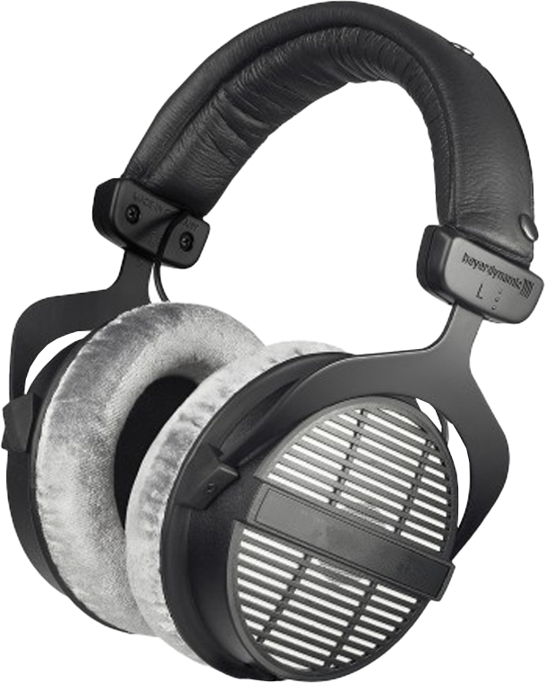
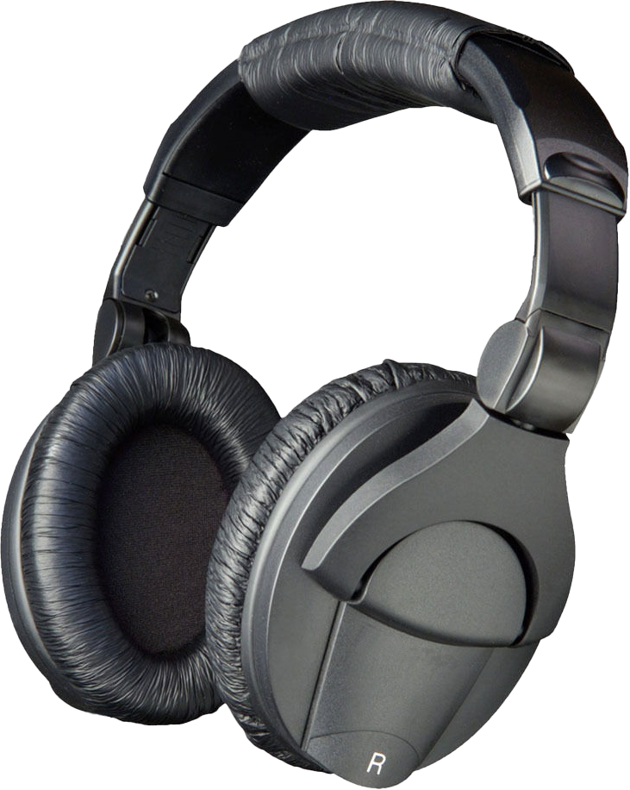
Open-back/Closed-back
Loud environments
High quality audio
Listening at home
Good for:
Bad for:
Sounds in your head
Planes/Office
Noisy places
Commuting
Good for:
Bad for:
Heat
Open back
Allows sound in/out
Closed back
Keeps sound in/out
ITFreeTraining.com
© Copyright 2023
Notes:
05:47 The most noticeable difference when purchasing a headset is whether it is open backed or closed back. As the name suggests, an open-back headset is not enclosed. Around the speakers there will be holes or gaps that allow sound to travel in and out of the headset.
By contrast, a closed-back headset is fully enclosed, thus the sound is kept in and also stops sound from entering the headset. Each has their advantages and disadvantages. For example, an open-back headset is good for listening to high-quality audio. This does not mean that closed back can’t be used for that, but open back allows sound to travel out of the headset. This prevents sound bouncing around the inside of the headset which can affect the way audio sounds.
Open-back headsets are good for listening to sound at home. To understand why, consider that they are bad for loud environments. This is because outside sound can easily enter the headset. This means the person wearing the headset will be able to hear background noise. At home, you won’t have a lot of background noise and if you do you should be able to control it. For example, moving your set up to a quieter area or closing some doors.
Now let’s consider the closed-back headset. This headset is good for noisy environments. This makes them good for commuting. If you are on a bus, for example, you don’t want to hear any of the background noise, such as people talking. At home, it is a different story because if someone is trying to talk to you when you are using your headset you may want to be able to hear them.
By blocking out external noise, closed-back headsets are good for noisy environments such as planes and offices. If you are trying to hear your audio and don’t want to be distracted by outside noise, closed-back headphones are a good choice. A perfect example of this is a DJ In an environment like this, the DJ only wants to hear the sound in their headset and wants to block out the loud outside sounds.
These headsets are bad for heat. Since no air can get inside, the air around your ears can heat up and over time it can get a little uncomfortable. The next disadvantage is because some of the sound can’t escape it bounces around the inside of the headset. This type of effect can make audio sound like it is inside your head.
The point to consider here is, that neither headset is better than the other, it depends on what you are using it for. Also, with headsets in a lot of ways you get what you pay for. The audio you hear in the headset will ultimately be directly related to how good the speakers are inside your headset. Let’s have a look at some of the things that you may want to consider before you purchase a headset.

Slide 6
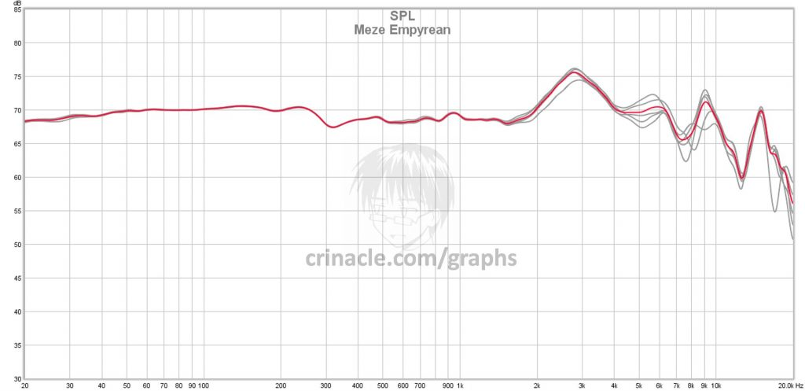
Frequency Response
Measure of output compared with frequency
Sub
Low
Lower mid
Higher mid
High
Bass
Mid
Treble
https://crinacle.com/ (Tests a number of headsets)
ITFreeTraining.com
© Copyright 2023
Notes:
08:58 One of the things that you may consider when you purchase a headset is the frequency response. For the CompTIA exam you really only need to know how to plug in a headset and troubleshoot it, so I have covered all the information you may be asked a question on. For the rest of the video, I will go through some of the things to consider before purchasing a headset. If you are going to spend a lot of money on a headset, it is not a bad idea to consider some of the specifications of the headset before you purchase it.
The frequency response is essentially a measure of the output compared with the frequency. To understand, let’s consider a graphic of frequency response for a headset. Not all headphones will provide this graphic, however there are some independent web sites that provide graphics of headset performance.
This graphic will give you an indication of how much output the headphones will provide at a certain frequency. To think of it another way, how loud a sound will be at a given frequency compared with the other frequencies. In a perfect world, you would want the headphones to output all frequencies at the same level. In the real world, speakers generally will be good in one area and poor in another. There is always a tradeoff. It is also important to understand that the frequency response is not an indication of quality. Just because something is loud does not mean that it will sound good. This graphic will give you an idea of what frequencies the headphone can produce, but not the quality.
When looking at frequency response and what you are trying to achieve, it is often good to break the frequencies up. At the low end is sub and low frequency, often called bass. Bass sounds are produced by instruments like double bass, cellos or tubas. They also produce sounds like explosions and earthquakes.
The next ranges are the “lower mid” and “higher mid” often called mid. Typically, about 80% of the sounds you hear in a home theater setup will occur here. This includes spoken voice or vocal. If you are using the headset for your telephone, you want good sound quality for this range.
The last range is high, otherwise known as treble. This range covers the higher end of human hearing. This includes soprano voices; these are singers that can sing at the highest frequency range, as well as flutes and symbols. Treble sound is the counterpart to bass sound. If you are in a room with a lot of bass playing you will feel the vibrations. By contrast, a room with a lot of treble will make your hairs stand on end.
When looking at headphones, a lot of them will give you a frequency response range in numeric form. This is not that helpful as it will only tell you what frequencies the headphones will produce and give you no idea of quality. For example, if you have a car and the speedometer goes up to 200, the vehicle may be able to get up to 200, however in the process this will put a lot of strain on the car’s engine. As a result, the vehicle may only be able to maintain this speed for a short period of time. With headphones, the manufacturer may say it can produce a certain range, however in practice the quality may be so bad or the volume so low, you won’t be able to hear it.
If a graphic like this is available, this helps as it will give you an idea of what kind of output you can expect. For example, a headphone may say it has a frequency response in the treble range, but the amount it can output is so low you will barely be able to hear it. Keep in mind that it all depends on your needs. For office use, you probably won’t need headphones that can produce sounds that are close to what only a dog can hear! However, if you are in audio production you may require this. Given that frequency response does not give us a good indication for the quality the headphones will produce, I don’t tend to pay too much attention to this when purchasing a headset. Let us have a look at some other specifications that may help you make your choice.

Slide 7
Impedance
Amount of power required to make it work correctly
Mobile devices provide less power
High impedance headphones won’t sound as loud
Headphones over 100 ohms generally professional
Better sound quality
However, quality of headphones make a difference
Modern amps can deal with either
ITFreeTraining.com
© Copyright 2023
Notes:
13:26 The next specification that I will look at is impedance. There are a lot of technical definitions about impedance and its relation to electric current. When looking at headsets, I will give you a simple way to understand how impedance affects headsets. Put simply, it is the amount of power that is required to make the headset work correctly.
Devices like mobile devices provide less power when compared with other devices. If you use high impedance headphones on a mobile device, since they provide less power the high impedance headphones won’t sound as loud. Essentially what occurs is, more power is required in order to create the sound.
Headphones over 100 ohms impedance are generally used for professional set ups. Generally, higher impedance gives better sound quality. This is because the extra impedance gives a higher range that can be used to transfer data. This results in better sounding sound, such as better bass and more spacious sounding sound. However, keep in mind that quality of headphones makes a difference. A low impedance headphone of good quality may sound just as good as a high impedance headphone of low quality.
Nowadays, modern amps can deal with either low impedance or high impedance headphones without any problems. The amp is essentially the electronics that amplifies the sound, so the signal is strong enough to be useful. Personally, I would look at the quality of the headphones to see if they are good enough to meet your needs. If you are considering using headphones in a mobile device, consider headphones with around 50 ohms impedance or lower. With technology getting better, you will find that the impedance in headphones is generally getting lower.
Your next consideration when choosing a headset will be what features it has. Let’s have a look at what you may consider getting.

Slide 8
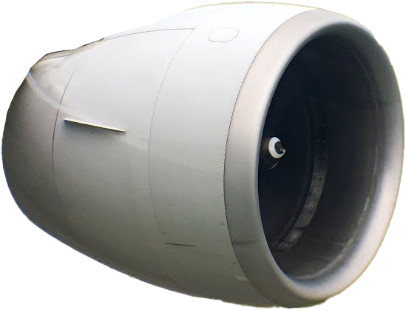
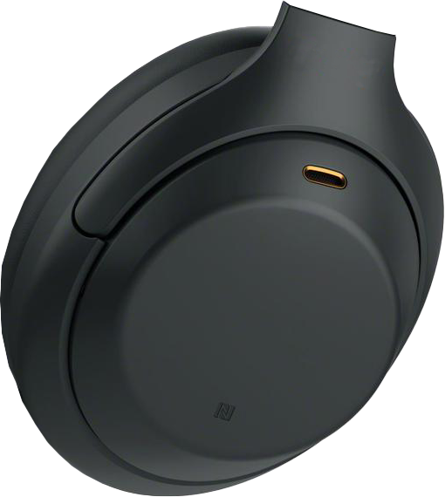
Noise Cancelling
Uses destructive interference to reduce noise
Microphone
Aircraft noise
Out of phase wave
Result
Not perfect (Works best with low-frequency sounds)
Costs more. Requires extra power
ITFreeTraining.com
© Copyright 2023
Notes:
15:31 The first feature that I will look at is noise cancelling. Noise cancelling uses destructive interference to reduce noise. To understand how this works, consider that you have some background noise like a jet engine. Jet engines and other noise making devices will emit loud noises, however this noise is fairly repetitive.
Noise-cancelling headphones work by having a small microphone in the headphones. This microphone records the background noise. The next step is to create an out of phase wave. This wave is the same as the background wave, however, when you compare it with the original wave you will notice that the wave is out of phase with the original, essentially a reverse of the original wave. When these waves are combined together the result will be a weaker version of the original wave. Now when the sound is added, the background noise will be reduced.
Noise cancelling is not perfect. It generally works best with low frequency sounds like engines. With sudden loud noises, like doors being closed, the noise cancelling may not be able to remove these sounds effectively. Essentially the noise cancelling is attempting to capture the background noise, reverse it and replay it – not something that can always be done perfectly and if you get it wrong, you risk distorting the sound you are attempting to play in the headphones.
Noise-cancelling headphones cost more than other headphones. This is due to the extra electronics in them. The extra electronics also requires additional power and thus in order to use noise cancelling you may need to install batteries in your headphones.
A good noise-cancelling headset will make a good seal around your ears to block as much noise as possible. Essentially think of it like earphones inside an ear plug. Because of this, they may also generate a little heat around your ears if you wear them for a long time.
Noise cancelling is not perfect, but if you are in an environment like an airplane, it may make your trip a little more bearable.

Slide 9
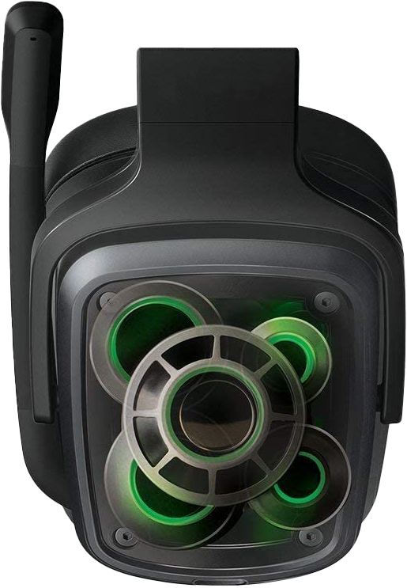
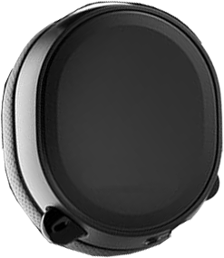
Surround Sound
Attempts to create surround sound effect
Virtual Surround Sound
Uses one speaker per ear only
Surround sound
Uses multiple speakers
Results not the best. (Personal preference)
ITFreeTraining.com
© Copyright 2023
Notes:
17:47 The last feature that I will look at is surround sound. Surround sound in headphones attempts to create a surround sound effect that your normally experience with a surround system like 5.1 or 7.1. There are two different ways to achieve this. The first is virtual surround sound. The surround sound system uses a single speaker for each ear, that is a total of two, for the headset. Essentially the headset attempts to re-create surround sound using only two speakers. You can guess that this will not give you a great experience since only two speakers are being used.
The next type of surround sound is one where there are multiple speakers inside the headsets to create a similar experience to that which you would get with surround sound speakers. Even using headphones with extra speakers, the results are not the best. Personally, I would spend the extra money on a better headset than purchasing surround sound, however, some people like the surround sound experience even if it is not perfect. Essentially you are attempting to re-create a room environment with speakers that are distributed in a small space. At times it may work, other times you may think the sound is coming from a different point than it really is. It is very difficult to re-create surround sound in such a small space.

Slide 10
What to Buy?
Depends on budget and needs
Is it a phone headset or for a computer
Open/closed-back headset
50 ohms or lower Impedance for mobile devices
Noise cancelling for noisy environment
Surround Sound (May not be as good as you expect)
Generally, you get what you pay for
Have a listen before you buy
ITFreeTraining.com
© Copyright 2023
Notes:
19:23 To conclude this video, I will have a brief look at what to consider for purchasing a headset. Ultimately your choice will be determined by your budget and your needs. With headphones the sky is the limit. You can pay a few dollars all the way up to thousands and beyond.
First, consider if you want to use the headset for a phone or a computer. In some cases, particularly with newer telephones that support USB, you may be able to use the same headset for a computer and telephone. Otherwise, your choice of headset may be limited to what is supported by that telephone.
Next consider if you want an open or closed-back headset. A closed-back headset is good for loud environments, but it will block out a lot of the sound around you. An open-back headset will not block out ambiental sound as much, so hopefully you will be able to hear people if they are talking to you. Closed back comes with the disadvantage of maybe getting sound that feels like it’s playing in your head, rather than it being a more natural sound.
If you are purchasing headphones for a mobile device, consider purchasing headphones that are 50 ohms or lower impedance. Higher impendence will still work, however depending on the mobile device you may not be able to get a high volume.
If you are using your headset in a loud environment, you may want to consider noise-cancelling headsets. These headsets will attempt to eliminate background noise, but they won’t be able to get rid of all noise. Different headsets will achieve this better than others. Due to the extra electronics required, the headset may require a battery to be installed. Given the extra electronics and battery, these headsets are generally larger and more expensive.
Some headsets may also include surround sound, however, don’t expect this to be as good as a surround sound system. Personally, I would spend more on a better headset but it is down to personal preference.
With headsets, you generally get what you pay for. However, as the price goes up the improvements get smaller. If you are a professional, you may want to spend hundreds of dollars for a headset you are going to use a lot, as it is probably a good investment. For home use, you can get some good results with a headset that does not cost a lot of money.
The best advice I can give you before buying a headset is put it on and have a listen. This will give you an idea how good it sounds, but also give you an idea how it will feel. If you are going to be wearing the headset for a long time you want something that feels good on your head.

Slide 11
Subscribe
Next video
Video content: https://ITFreeTraining.com/ap/2c65
© Copyright 2023
Notes:
22:19 This concludes this video on headsets; hopefully this gives you an idea of what sort of headset to purchase or at least where to start. I hope you have found this video useful, until the next video from us I would like to thank you for watching.
References
“The Official CompTIA A+ Core Study Guide (Exam 220-1001)” Section 5 Paragraph 218 - 222
“CompTIA A+ Certification exam guide. Tenth edition” Page 423
“Headset (audio)” https://en.wikipedia.org/wiki/Headset_(audio)
“How do headphones really work? (4K) - Part 1/5 - "All About Headphones"” https://www.youtube.com/watch?v=_W2z-ikIgM0
“Open-back vs Closed-back headphones? (4K) - Part 2/5 - "All About Headphones"” https://www.youtube.com/watch?v=DS4T_1UyCHw
“Are frequency response and spectrum graphs important? (4K) - Part 3/5 - "All About Headphones"” https://www.youtube.com/watch?v=BNYitfi-43I
“What is headphone impedance? (4K) - Part 4/5 - "All About Headphones"” https://www.youtube.com/watch?v=GQWLuAEelcc
“What are the best headphones? (4K) - Part 5/5 - "All About Headphones"” https://www.youtube.com/watch?v=K6NzECeUjSg
“Picture: White cat” https://pixabay.com/photos/cat-white-animal-mammal-feline-3591348/
“Picture: Frequency Response” https://crinacle.com/graphs/headphones/meze-empyrean/
Credits
Trainer: Austin Mason http://ITFreeTraining.com
Voice Talent: Tomislav Krevzelj
Quality Assurance: Brett Batson http://www.pbb-proofreading.uk

