Slide 1
Notes:
In this video, I will look at Sound Recording Equipment. If you are planning on recording audio, depending on your requirements, you may need to purchase some sound recording equipment to get good results.

Slide 2
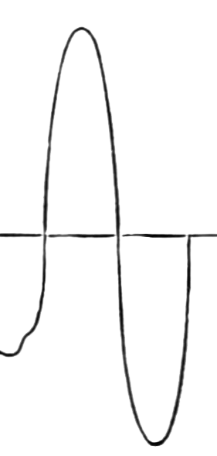
Analog to Digital
Converting analog wave to digital
Analog Wave
2-bit
3-bit
Sample rate
Sample rate
Sample rate: Number of times wave is measured per second
Bit depth/Sample depth: Resolution sample is recorded at
ITFreeTraining.com
© Copyright 2023
Notes:
00:12 To understand how sound equipment works, I will first look at the process of converting analog to digital. To understand this, I will first look at an analog wave. To convert the wave from analog to digital, there are two different measurements that are used on the wave. Changing the precision of these measurements will affect the quality the wave is recorded at.
The first characteristic measured is the sample rate. The sample rate is the number of times per second that the sound wave is measured. The second is the bit depth or sample depth. This is the resolution the sample is recorded at.
To understand how this works, consider that we have a sound wave that we want to convert to digital. To do this, first you need to decide what sample rate you want to use. This will determine how often the wave is measured. The next thing to consider is how the wave is measured. In this example, I will consider that 2 bits are used to measure the wave. You probably will use a lot more than 2 bits to measure a wave, but to make it easy to understand, I will use 2 bits.
To convert the wave to digital, the wave is measured, and the result stored using a 2-bit value. Essentially, the wave is measured, and the height of the wave is recorded. You can see that using 2 bits allows us to effectively record four different positions of the wave.
If I now compare the same wave, however this time using 3 bits, this will give us eight values. Notice that, when the wave is sampled using 3 bits, this gives a better result than for 2 bits, even using the same sample rate – notice that since there are more values, we can better represent the wave. Thus, the more bits you use the better results you will get.
In this case I have used 2 and 3 bits to illustrate the concept. In the real world, 8, 16 and 24 bits are commonly used. 16 bits is the standard for CDs. 24 bits is used for DVDs and professional equipment. More bits are better; however, this does increase the size required for the data file. With the amount of space that we have available nowadays, this is not generally a problem; however, for applications where size is a concern, 8 bits may be used. For example, when transmitting voice over a telephone line or for audio conferencing over a slow internet connection, the application may use a bit depth of 8.
So now that we have had a look at what the process of converting an analog wave to a digital wave is, I will next have a look at how we can work out how much space we will need.

Slide 3
Bit Rate
Bits required for audio encoding per second
Frequency × bit depth × channels = bit rate
44,100 × 16 bits per sample × 2 channels
= 1,411,200 bits per second or 1,411kbps
Size of 240 second file
= 1,411,200 x 240 = 40.37 Megabytes
ITFreeTraining.com
© Copyright 2023
Notes:
02:52 The number of bits required is measured as a bit rate. The bit rate is essentially the number of bits required for audio encoding per second. It is calculated by multiplying the frequency, bit depth and number of channels.
Let’s consider a typical example, such as what is used for encoding audio on a CD. The frequency is 44.1k, 16 bits for audio and two channels. This will give a result of 1,411 kilobits per second. If I apply this to a 240 second file, this will give a result of just over 40 Megabytes. So, we now have some idea of how to encode sound and how much space is required. The next step is to look at how we are going to record it.

Slide 4
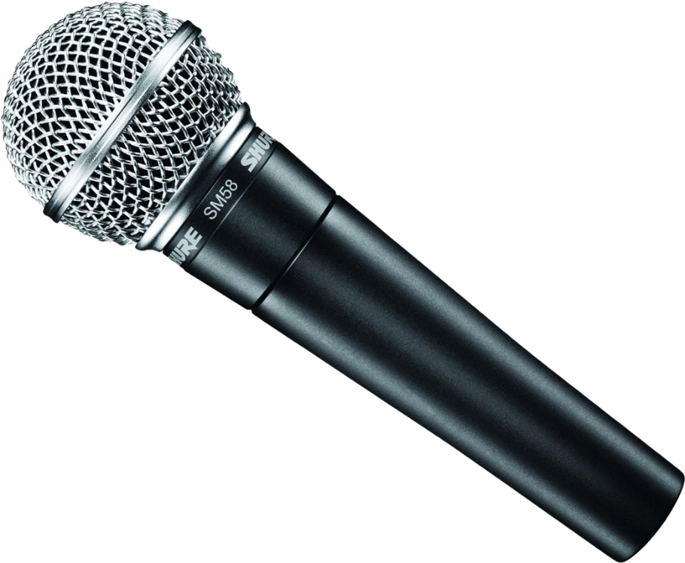
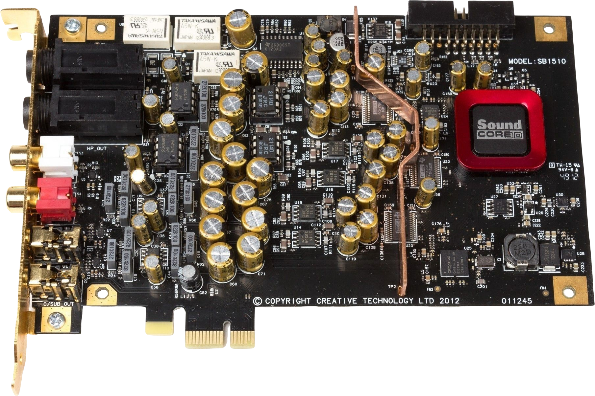
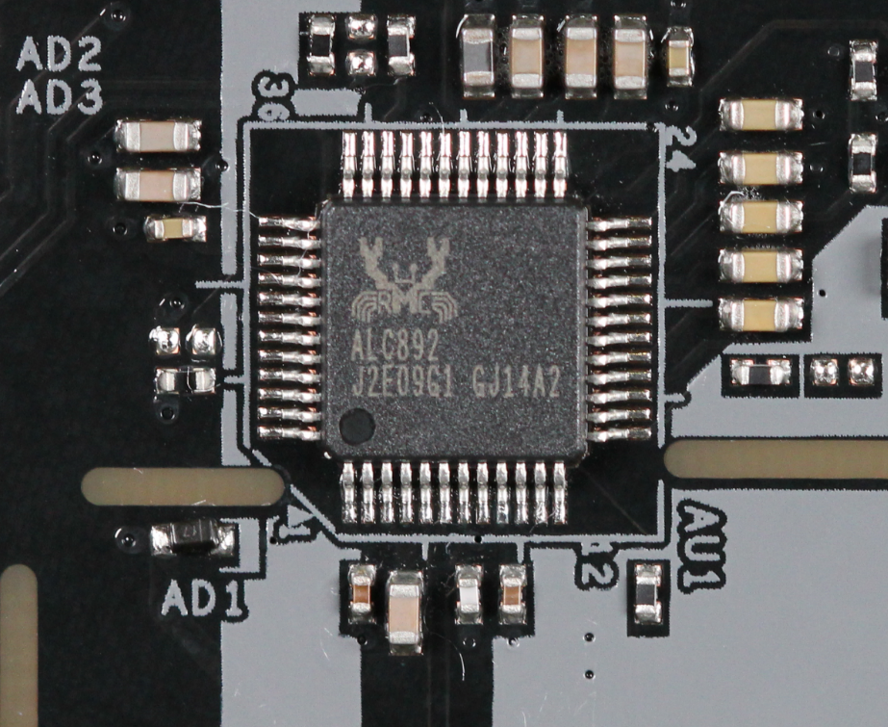
Analog to Digital Converter (ADC)
Converts analog to digital
On-board sound adapter
Subject to interference
Audio quality varies
External audio box
Not subject to interference
Good quality audio
Sound card
Interference shielding
Good quality audio
ITFreeTraining.com
© Copyright 2023
Notes:
03:43 Since audio is analog, you will need some way to convert the analog wave into digital. In order to do this, an analog to digital converter or ADC is required. This is a device that is connected between your microphone and the computer, that will convert analog to digital. The simplest solution is often to use the on-board sound adapter.
On-board sound adapters are generally very cheap to make but their audio quality can vary. They are also subject to interference, as inside the computer there are a lot of electromagnetic fields. Motherboard manufacturers will attempt to place the audio chip away from electromagnetic fields. Some manufacturers will do a better job of this than others. If you are attempting to record quality audio, it is recommended not to use an on-board sound adapter.
An alternative to this is to use an external audio box. An external audio box is not subject to internal interference, since it is designed with electromagnetic fields in mind. Audio boxes will be of good quality; however, you should check the specifications before purchasing to make sure that it will do what you require.
The next alternative is to use an internal sound card. An internal sound card will generally have interference shielding. Interference shielding will help block interference, giving better sound recording. However, it can only do so much. There is a difference of opinion on whether an external audio box or sound card is better, but both will give you good quality audio.
In some cases, you won’t need either, let’s have a look at when this is true.

Slide 5
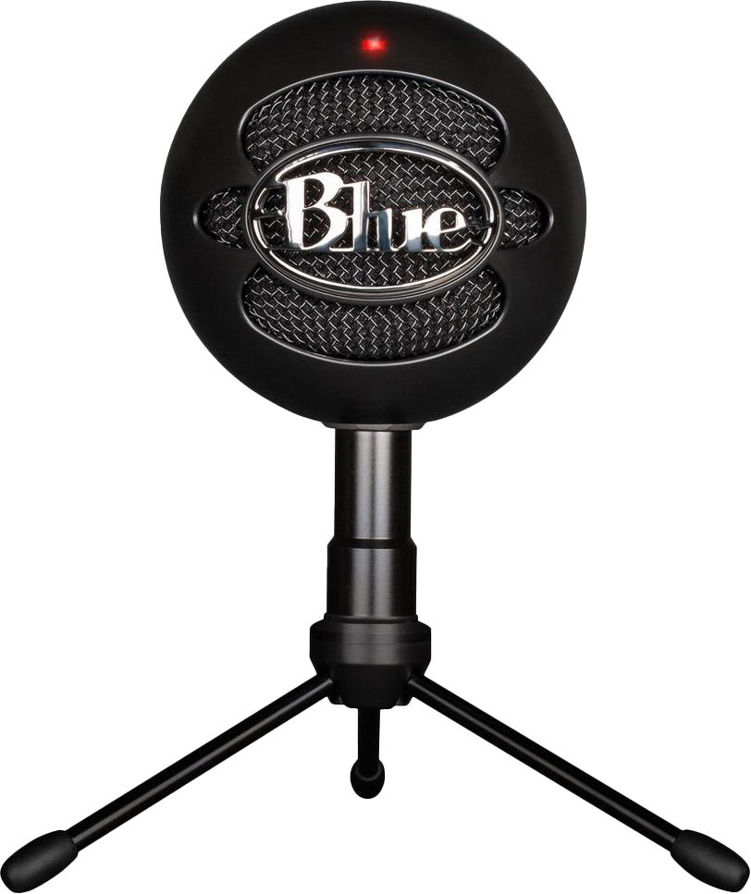
Internal ADC
Some microphones convert analog to digital
Audio transfer to computer using USB in digital format
ITFreeTraining.com
© Copyright 2023
Notes:
05:27 In some cases, the device you are recording from may have an internal ADC. This will perform analog to digital conversion. For example, some microphones convert analog to digital. This will generally mean that the audio will be transferred in digital form to the computer using USB. This has the advantage that you won’t require any additional equipment other than the microphone. Devices like this are very popular due to the fact that they can just be plugged into the computer and are easy to set up.
Now that we have had a look at how to record audio, let’s look at what can affect what you’re recording.

Slide 6
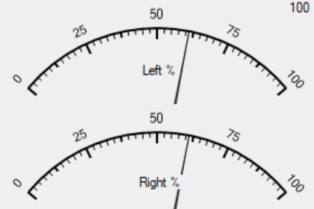
Signal-To-Noise Ratio (SNR)
Ratio of noise to desired signal (Audio) E.g., SNR 105dB
Noise
Noise
Optimal level
Too high
Increase recording level will also increase noise
Noise will increase less than audio will (Ratio)
Optimal level is a high recording level without clipping
ITFreeTraining.com
© Copyright 2023
Notes:
06:06 When purchasing sound recording equipment, there are a number of specifications you can look at which will give you an idea of the recording quality you can expect. One of the specifications is
signal-to-noise ratio. Signal-to-noise ratio is the ratio of desired audio signal. For example, a
signal-to-noise ratio, or SNR, may be 105 decibels. So, if you are recording at 105dB, you may get up to one dB of noise. Thus, a higher ratio is better.
To understand how this effects recording, consider you are recording some audio. In the audio there will be some noise. There will always be some noise when you are recording, regardless of how good the equipment you are using. The easiest way to see how much noise there is, is to look at the wave when everything is quiet. When audio is recorded, the noise will be combined with the recorded audio and thus be difficult to determine what is noise and what is the recorded audio. Thus, removing the recorded audio, you will only be able to see the noise. This will give you an idea of how much noise you have.
In order to get a better result, the easiest solution is to increase the recording level. Increasing the recording level will also increase the noise level. You can see in this example that increasing the recording level has increased the noise as well. However, the noise has increased at a lower rate than the audio. This is why it is called a signal-to-noise ratio. The higher the signal-to-noise ratio, the better. So, to get the best out of your recording equipment you want your recording equipment to be at a high recording level. However, the optimal level is a recording level you can achieve without clipping.
Clipping will occur when the sound levels are too high. Essentially, the audio level is at a higher level than the highest number the audio equipment can record. For example, consider you have a tape measure and you are trying to measure something that is bigger than the tape measure! In sound recording, the application will clip to the maximum value. So essentially this would be the largest number on the tape measure.
To get the correct levels, most recording equipment will have some way to measure the audio level. Often this would be by the use of a volume unit or VU meter. To get the optimal level, generally you want the audio to be between 50% and 75% on the VU meter. This is an average; so, for example, if you are recording audio of someone speaking, you want the level to be within this range.
Clipping will occur when the audio gets too high. So, if you find your audio is in the high range, there is a chance it will be getting clipped. Keep in mind that the audio level will fluctuate from low to high all the time. Therefore, if you are finding that the audio level spends too much time in the high range, consider turning the levels down. Having it fluctuate to the high range now and then should not be a problem. To get optimal results, attempt to find a recording level where the audio being recorded spends most of its time around the three-quarter range on the audio meter. Most audio meters will have this range marked in a yellow color.
This range will give you the best audio recording without clipping, as the ratio of noise amplification is high, so you should get good results. If your recording level is too low, there won’t be a good ratio between noise and audio. When this occurs, you will hear the noise in your recording. If you find your audio is too loud, you are best to record it loud and then reduce the volume in later steps. For example, reduce the recording volume on the computer rather than on a device like an external audio box.
Having good recording equipment is one thing; however, in order to reduce your noise further, you should consider your room setup.

Slide 7
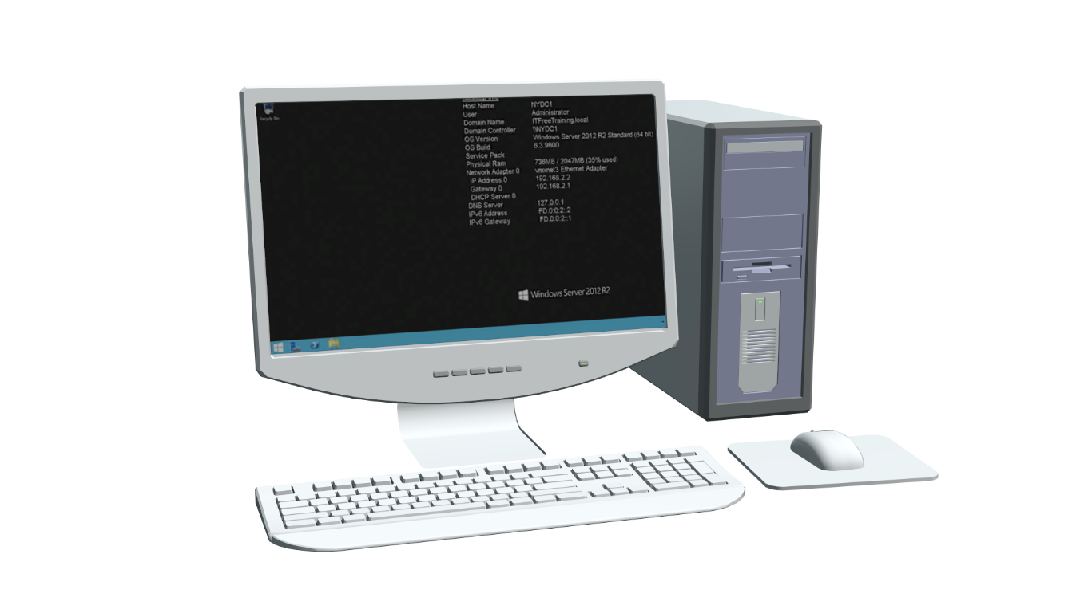
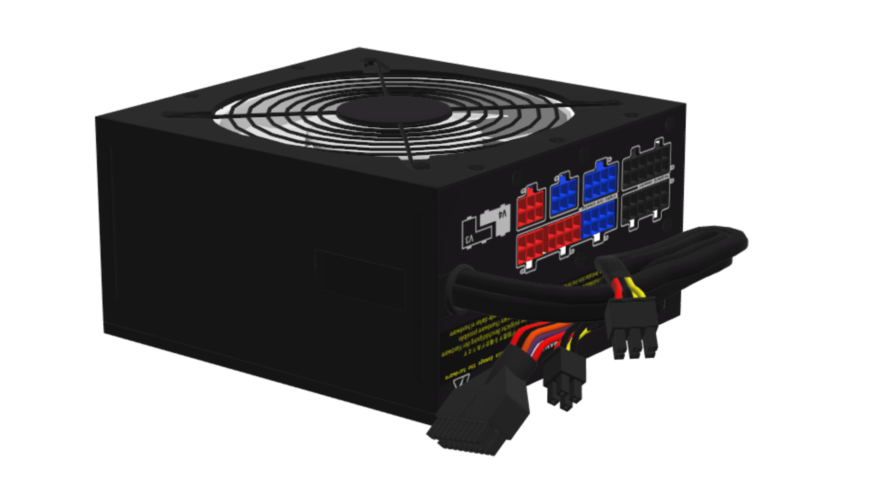
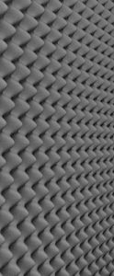
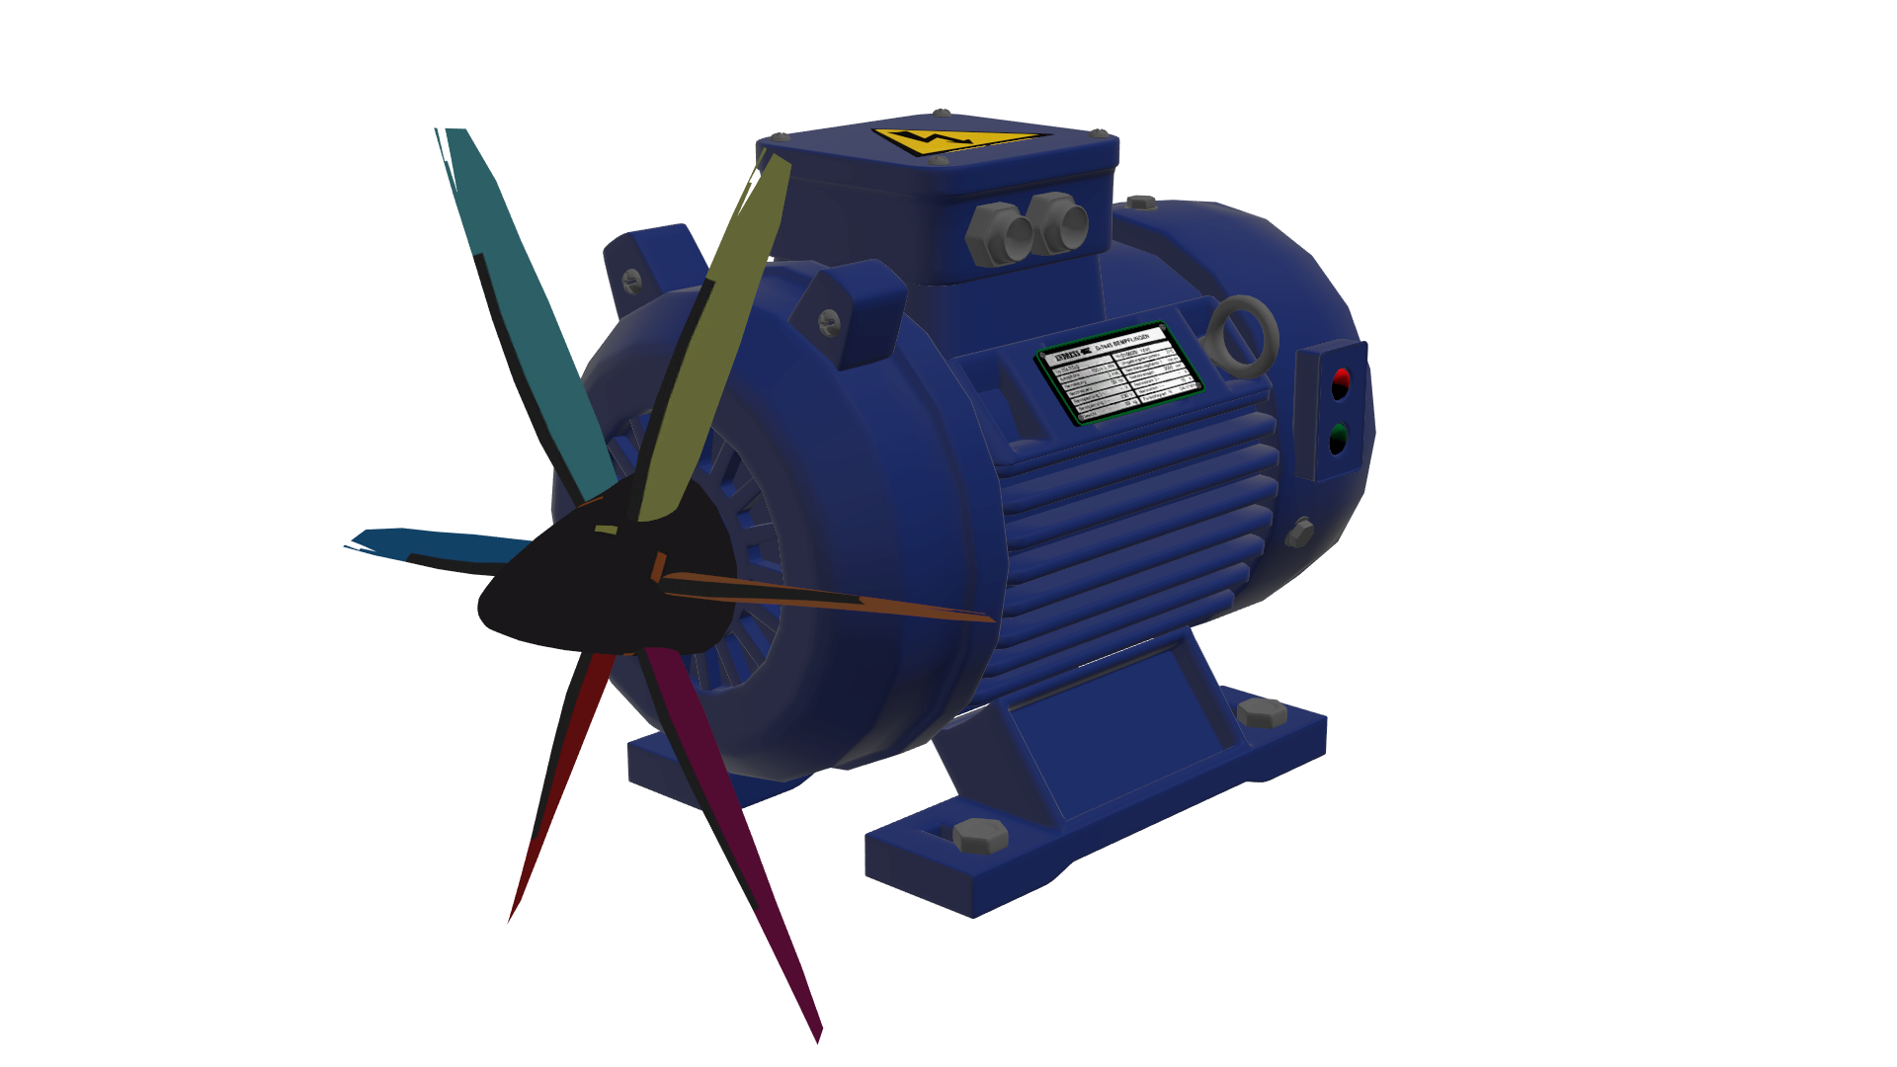
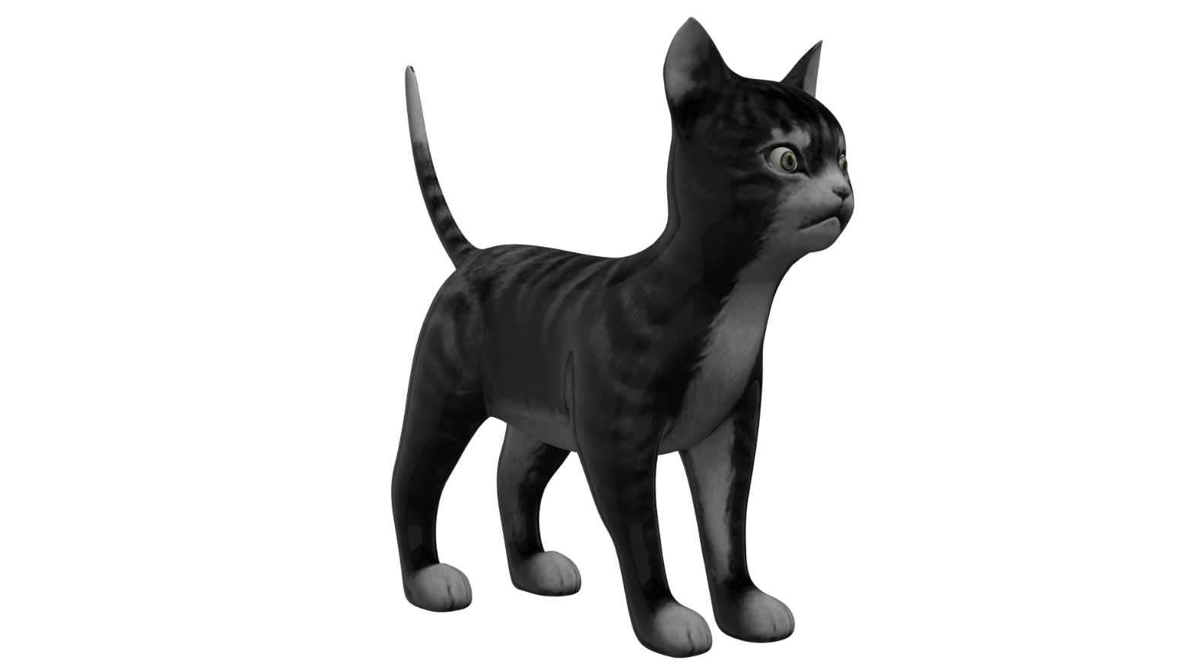
Room Setup
Move/remove anything making
noise/interference away from
the microphone
Echo caused by repeated
reflection of sound
Sound bounces between wall
Causes echo
Sound bounces at random
angles reducing echo
Bookshelf
Foam
ITFreeTraining.com
© Copyright 2023
Notes:
10:12 There is a lot that occurs when setting up a room for audio recording. I could spend hours talking about it, but for this video I will consider the basics. The first thing to consider is to move or remove anything that makes noise or causes interference.
If your computer is too close to the microphone, the microphone will pick up the noise or interference from the computer. This includes anything making noise such as hard disks, optical drives or fans. Don’t forget anything that causes electrical interference. Electrical interference can cause unwanted noise if the microphone is too close to the computer. For best results, if you can’t eliminate the computer from the room, move it so it is not so close to the microphone. This should be easy to achieve with a decent length of quality cable.
One of the biggest noises made in a computer is the power supply. Besides the loud fan, they also generate electromagnetic interference. Keep this in mind for any electronic device that is near your microphone. I once had a very low humming noise from a microphone. After removing the computer and everything else I could find that made noise, I still had the hum. I eventually worked out that the noise was coming from the monitor. Once I moved the microphone away from the monitor, the noise stopped. Having an electronic device too close to the microphone can cause problems like these.
Also consider any devices with electric motors in them. Devices like air conditioners can cause problems. You don’t want devices like washing machines near the microphone or don’t use them when you are recording. Hopefully you won’t have to switch your air conditioner off when you are recording.
Lastly, even if they are really cute, it is best to move any pets out of your recording area. The next problem you may come across is echo. Echo is caused by sound repeatedly bouncing between two surfaces. The most common example of this is two walls. As the sound bounces between two surfaces, at some point the waves of the sound will combine together and thus increases in intensity causing an echo to be heard.
To eliminate this, the sound needs to be prevented from bouncing back and forth. When sound bounces like this, the sound wave will become more intense causing you to hear an echo. You will find this problem will occur more often in small square rooms. Since the room is square the sound will bounce from wall to wall quite quickly, since it does not have to travel too far. The larger the room, the more the sound wave will reduce in intensity before hitting the wall, thus reducing how loud the echo is.
To prevent this from happening, the simplest way is to prevent the sound from bouncing between surfaces which are parallel to each other, like walls. To do this, special acoustic foam can be used. In some cases, this may not be possible. For example, because of the costs involved or perhaps you can’t make changes to the room. Essentially, you only need to prevent the sound bouncing at right angles, so even something as simple as using a bookshelf will help – as long as the object is not flat so all the sound waves aren’t bouncing back in the same direction. Since you are only preventing the sound waves bouncing from wall to wall, you only require this on one wall.
When you are setting up your sound equipment, consider how to set up your room. If you can’t change the room, consider moving the microphone to a different location in the room. Hopefully this will allow you to get some good results.

Slide 8
In The Real World
Sample rate
8kHz (Minimum for speech)
44kHz (Professional and CD quality)
Higher if doing post-production work
Bit depth
8-bit (Size is important/Telephone)
16-bit CD quality
24-bit professional use
Larger for post-production (Extra resolution)
ITFreeTraining.com
© Copyright 2023
Notes:
13:54 In the real world, when recording audio, you will need to configure specifications for the audio recording like sample rates. For speech, an 8kHz rate is the bare minimum. This is not suitable for audio such as music.
For professional quality, you want to look at 44kHz. This is the sample rate used for CDs. If you are planning to do post-production work, you may want to consider a higher sample rate. This becomes important in post-production when you start mixing multiple audio streams together and applying effects. This is generally only used in professional production houses, for example on a production house working on the next Hollywood blockbuster movie. If you are not working on a project like that, then around 44kHz is a good sample rate to choose.
For the bit depth, 8-bit is used when size is important. In old telephone systems and telephone applications 8-bit was used. For better quality, and as a good starting point, 16-bit should be used. This is the sample rate that is used for audio CDs.
For professional use, 24-bit should be looked at. All professional audio recording devices should support 24-bit recording. Audio files are quite small compared to files like video files, so if you are not sure and you have the space, higher is generally better. You can always reduce the sample rate or bit rate later on if you need to.
For post-production devices, you may see larger bit depths. For example, 32-bit or even 64-bit. The idea behind this is that when combining audio together, having the extra resolution gives a more accurate result. However, the final result will most likely be 24-bits or less.
There is a lot to audio recording, and it is quite easy to make a video going on about it for hours. The good news is audio technology has come a long way and even cheap devices do a fairly good job. If you want some good results, consider purchasing mid-range semi-professional recording devices. These should give you some good results; anything beyond that is generally used only by the serious professional and the perceived benefits become very small as the cost goes up.

Slide 9
Subscribe
Next video
Video content: https://ITFreeTraining.com/ap/2c50
© Copyright 2023
Notes:
16:14 Thanks for taking the time to watch this video from ITFreeTraining. I hope this has helped you work out what you may need for your audio recording setup. Until the next video from us, I would like to thank you for watching.
References
“The Official CompTIA A+ Core Study Guide (Exam 220-1001)” Chapter 5 Paragraph 213 - 218
“CompTIA A+ Certification exam guide. Tenth edition” Pages x – x
“Sampling (signal processing)” https://en.wikipedia.org/wiki/Sampling_(signal_processing)
“Digital-to-analog converter” https://en.wikipedia.org/wiki/Digital-to-analog_converter
“Signal-to-noise ratio” https://en.wikipedia.org/wiki/Signal-to-noise_ratio
“Signal To Noise Ratio” https://www.youtube.com/watch?v=w4IcAkrNFn0
“Sound wave” https://www.pngfuel.com/free-png/aagog
“picture: bookcase” https://unsplash.com/photos/VNCz-57rm10
Credits
Trainer: Austin Mason http://ITFreeTraining.com
Voice Talent: HP Lewis http://hplewis.com
Quality Assurance: Brett Batson http://www.pbb-proofreading.uk

