Slide 1
Notes:
In this video I will look at microphones. Microphones essentially allow us to capture sound waves and convert them into digital data. This video will look at the basics of how microphones work and what to consider when purchasing one.

Slide 2
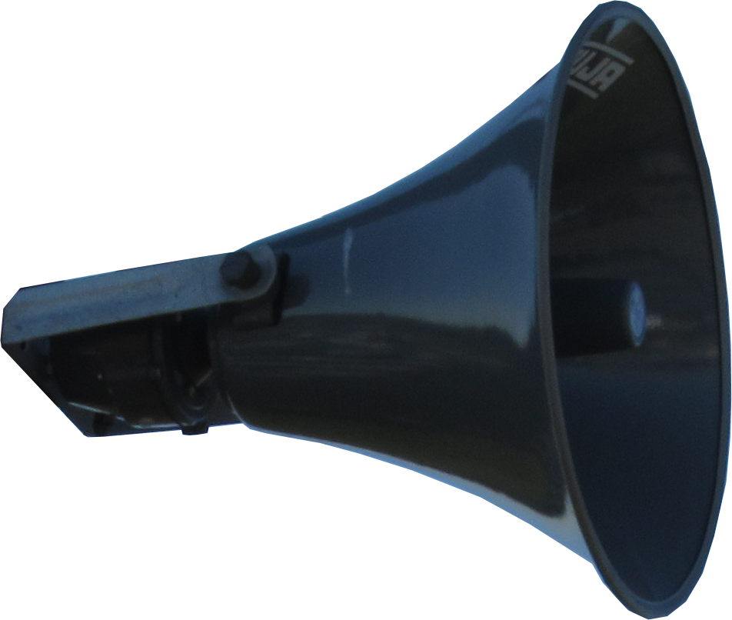
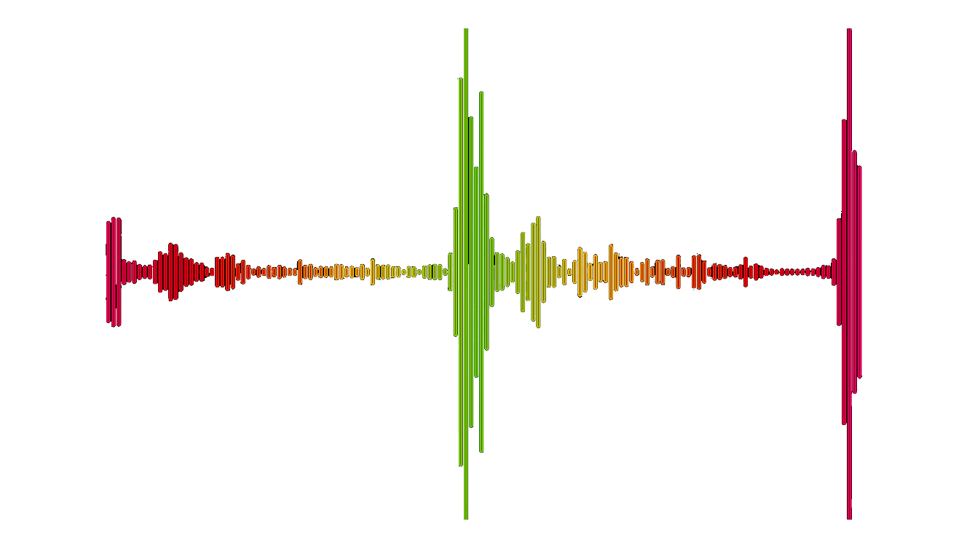
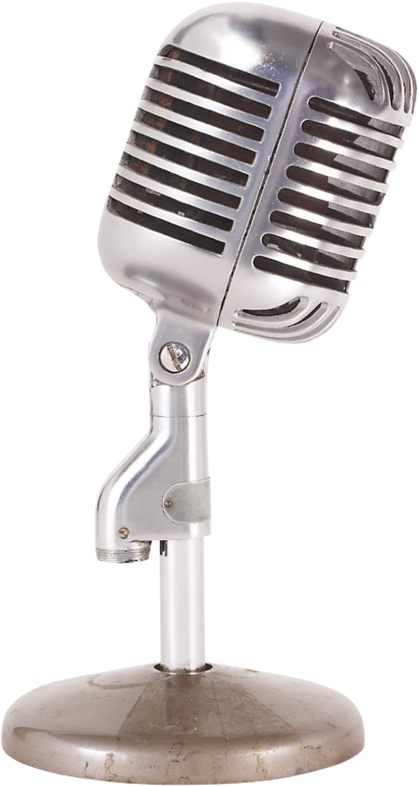
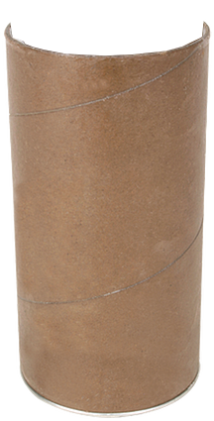
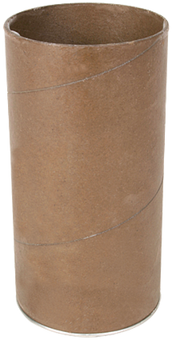
How Does a Microphone Work?
Device converts sound energy into electrical energy
Amplification
(Preamp)
Sound waves
ITFreeTraining.com
© Copyright 2023
Notes:
00:16 To start with, let’s have a look at how a microphone works. A microphone is essentially a device that converts sound energy into electrical energy. That is basically it, but to understand the differences between different microphones and different microphone setups, it helps to understand the components that make microphones work.
To start with, let’s consider that you have something that is making noise, in this case some fireworks. The fireworks will make noise which will travel through the air in sound waves. In order to capture these sound waves, this is where a microphone is used. The microphone turns the sound waves or kinetic energy into electrical energy.
There is a small problem with this approach and that is the amount of electrical energy captured is very small. In order to get something useful, the signal is amplified. The result is a signal is created that we can use. This amplification is often referred to as preamp.
Once you understand the basics of how a microphone works, your next step is to understand the differences between different setups and what equipment you may need. To start with, let us look at one of the easiest ways you can record audio on your computer.

Slide 3
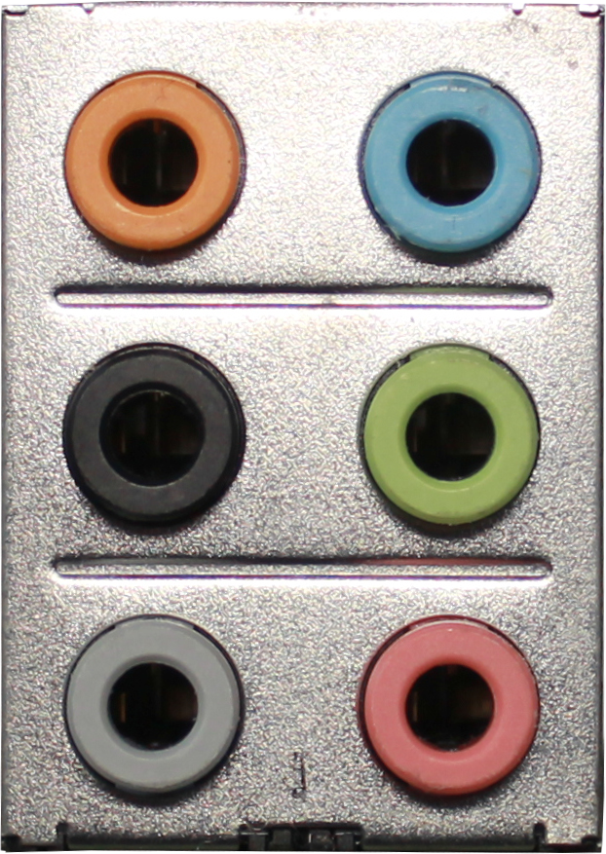
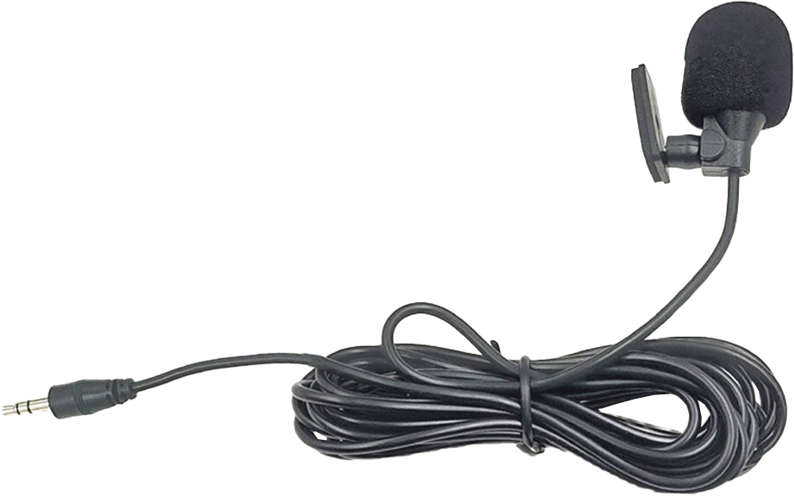
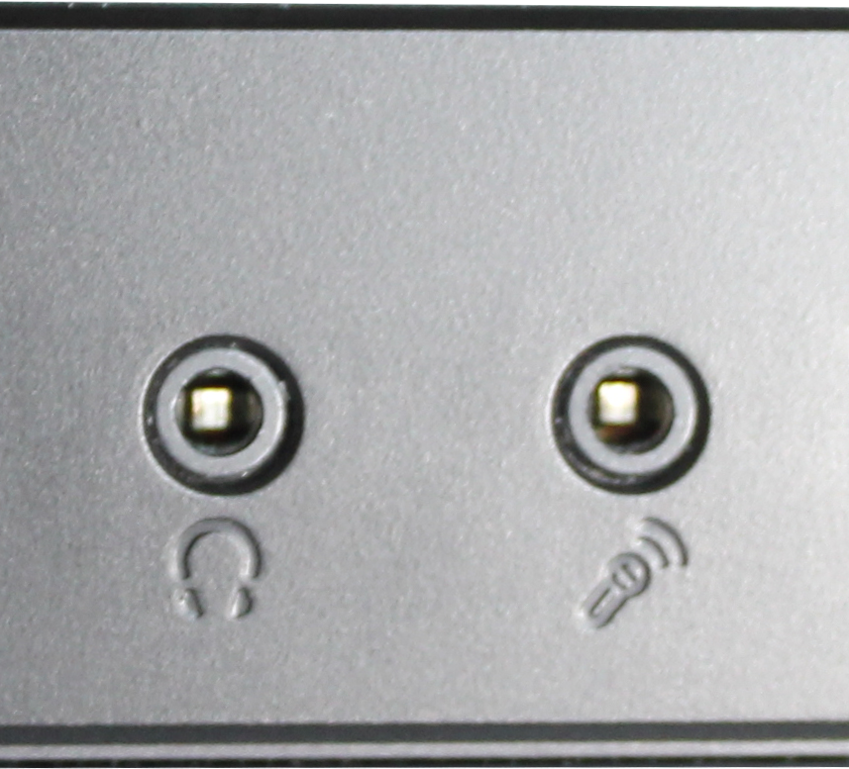
Mic-In
Preamp required in computer (5 – 50 millivolts)
Mono microphone in (Pink)
Maybe marked
ITFreeTraining.com
© Copyright 2023
Notes:
01:35 One of the easiest ways and also the one of the oldest, is to plug the microphone directly into the computer. Generally, on most computers the microphone plug will be pink although, in some cases, you may find the plugs are not color coded.
The mic-in plug supplies a small amount of voltage to the microphone. When I say small, I mean in terms of millivolts. For this reason, a preamp is required in the computer to boost the microphone signal.
If you only require some basic recording, a mic-in microphone may meet your needs. As we will see, not all microphones are created equal. Generally speaking, the more you pay for the microphone the better quality the microphone will be.
In the case of a plug-in microphone like this, it does not require any additional power to operate. Some microphones will require additional power. Let’s have a closer look at how a microphone works in order to understand where and when you won’t require additional power.

Slide 4
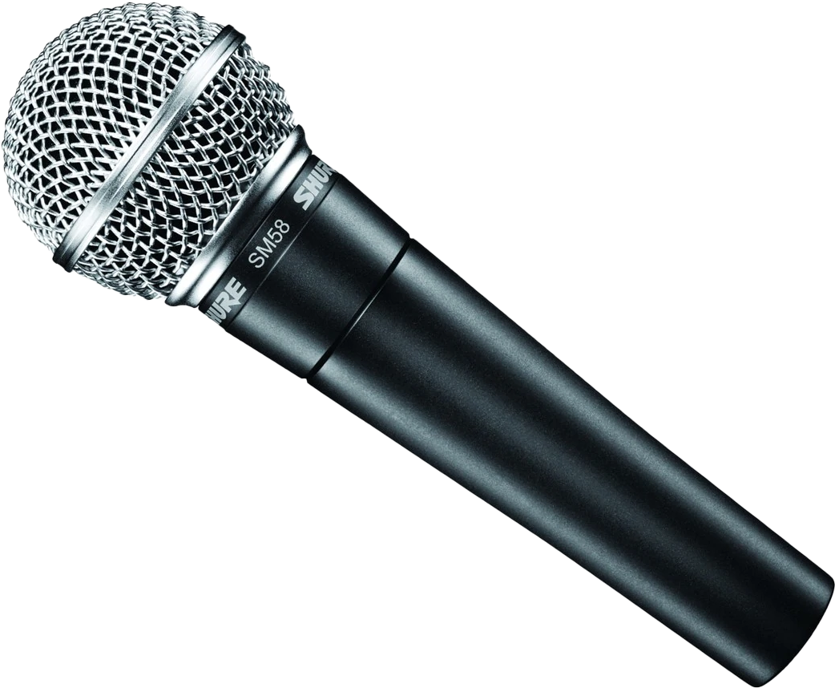
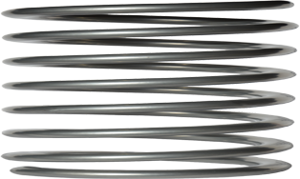
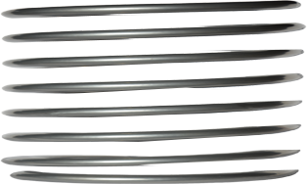
Dynamic (Moving coil)
Sound waves
Diaphragm
Rugged/strong/cheap
Does not require power
Slow moving/better for low frequencies
Magnet
Vocals/drums/live performances
Limited high-frequency response
Diaphragm moves coil
Electric current induced by moving coil
ITFreeTraining.com
© Copyright 2023
Notes:
02:36 There are a lot of different microphones on the market; however, they can generally be separated into two different categories. Most other microphones on the market are just variations of these two basic types. The first one I will look at is dynamic, which is also known as moving coil. Microphones can be designed in many different ways, but dynamic microphones will often be designed in a particular way.
To understand how dynamic microphones work, consider that you have a sound wave. In order to convert kinetic energy from the sound wave to electrical energy, a diaphragm is used. A diaphragm is a piece of material that moves when the sound hits it. It is the same principal as a speaker except in reverse.
In order to capture the movement, a coil is attached to the diaphragm. This will move with the diaphragm. The next component is a magnet. When the coil moves through the magnetic field of the magnet it will induce an electric current in the coil. This electric current is measured and effectively the sound energy has now been converted into electrical energy.
The advantage of dynamic microphones is that they are rugged, strong and cheap to make. In order to operate, they do not require any external power. Due to the sound having to move a coil through a magnetic field, it is slow moving and works best for low-frequency sounds. Thus, it is good for vocals, drums and live performances due to its rugged design. Essentially, these microphones can be used in loud environments and are fairly resistant to external forces. For example, they are pretty resistant to being dropped and thrown around; however, don’t go trying this out because they are not indestructible.
Due to the coil moving slowly, there is limited response to high frequency. High-frequency waves change very quickly, and the coil simply can’t move fast enough to capture them accurately. High-frequency sounds are like a high-pitched whistle. Dynamic microphones can pick up high-pitched sounds like these but won’t do a good job of recording them. In order to pick up those high- frequency sounds well, a different type of microphone is required.

Slide 5
Condenser
Sound waves
Diaphragm
Not as durable as dynamic
Back Plate
Used in sound studios
Captures high frequencies better
Flutes/cymbals
Generally, costs more
Phantom power
Diaphragm movement detected by back plate
Both diaphragm and back plate electrically charged
ITFreeTraining.com
© Copyright 2023
Notes:
05:01 To record high-frequency sounds, a condenser microphone is a better choice than a dynamic microphone. To understand how this works, consider that you have your sound waves as before. Initially the process starts out much the same as for the dynamic microphone. The sound waves hit the diaphragm, as before, making it move.
In order to detect this movement, a back plate is positioned behind the diaphragm. This back plate is able to detect small movements in the diaphragm. This makes it more sensitive than a dynamic microphone which is particularly useful for accurately detecting those high-frequency sounds.
In order to get this to work, as before, there has to be a magnetic field. However, this is where condenser microphones now differ. Rather than using a permanent magnet, instead the diaphragm and back plate have power applied to them which creates a small magnetic field. This power is called ‘phantom power’.
Phantom power can be supplied through the cable or by using internal power. Internal power may be supplied through the use of a battery. Because the power can be anywhere, this is why it is called phantom power.
Condenser microphones are not as durable as dynamic ones, so I would not go throwing them around, not that you should be throwing any microphones around. Since condenser microphones are more easily damaged, you won’t see them used at a rock concert, more likely you will see them used in sound studios. This is because they capture high frequencies better and other environmental factors can also be controlled. For example, because dynamic microphones are more durable, they are more resistant to moisture and thus can be used outside. Condenser microphones are more suited to be used inside such as in a studio.
Since condenser microphones are better at recording high frequencies, they will often be used for capturing sounds from instruments like flutes and symbols. This is why in a studio you will often see condenser microphones used to capture sounds from instruments like these, however a dynamic microphone is used for something like a bass drum. This is why one microphone is not generally better than the other, they both have their advantages and disadvantages.
Condenser microphones generally cost more than dynamic microphones. I say generally because this is the case when you look at the average price. With microphones, if you buy the top of the line dynamic microphone it will cost more than the cheapest condenser microphone. In a lot of cases with microphones you get what you pay for. So, your choice of microphone should be based on what you want to pay and what you want to achieve.
If you decide to purchase a condenser microphone, you will need phantom power. Let’s have a closer look at how that works.

Slide 6
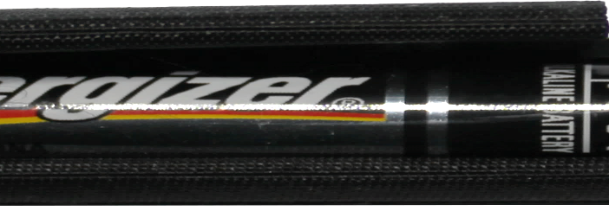
Phantom Power
Can be any voltage
12v, 24v, 48v (ANSI standard) 48v most common
Make sure voltages match
E.g., audio box provides 48v phantom power
Preamp/mixers can provide phantom power
Battery provides power
ITFreeTraining.com
© Copyright 2023
Notes:
08:03 Phantom power can be any voltage: 12 volts, 24 volts and 48 volts are all defined in the ANSI standard for phantom power. 48 volts is the most commonly used, so don’t be surprised when people talk about phantom power they are assuming it will be 48 volts. The important point is to make sure that the phantom power supplied matches your microphone.
There are many different ways to provide phantom power to your microphone. One common way is to use a device like an audio box. In this example the audio box provides 48 volts of phantom power to the microphone. The audio box, in this case, connects to the computer using a USB cable. However, it could be connected using the line-in or microphone jack.
There are also other devices on the market that can provide phantom power. For example,
preamps and mixers can provide phantom power. If you find your condenser microphone is not working, it maybe that you need to switch the phantom power on. There will usually be a switch on the device which switches the phantom power on or off.
In some cases, the phantom power may be supplied by a battery. Condenser microphones don’t use a lot of power so the battery won’t need to be changed that often.
Now that we understand the basics of how microphones work, let’s have a look at how, in the real world, you can get some good results.

Slide 7
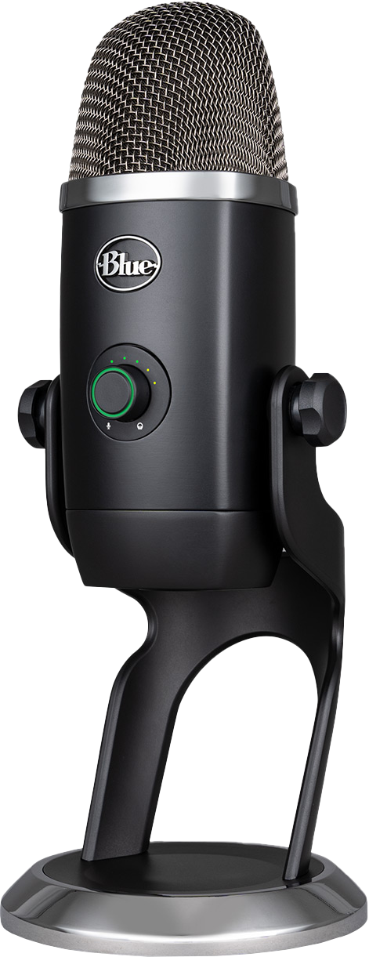
In The Real World
Blue Yeti (Condenser)
Shure (Dynamic)
Consider audio box
USB Microphone
Outdoor/Loud concert
rather than using mic-in
Audio control on front
Direct mic-in results vary
Chosen by many streamers
Mic-in subject to interference
ITFreeTraining.com
© Copyright 2023
Notes:
09:27 If you are looking at getting some professional results, don’t want to spend too much and want a simple solution, consider a USB microphone like a Blue Yeti. These microphones are simple to use as they just plug into the computer using the USB port. The Blue Yeti is a condenser microphone and therefore requires phantom power, however this is supplied by the USB cable so you don’t need to worry about it.
The Blue Yeti has audio controls on the front to easily change the recording volume and it also has an audio meter on the front so you can see what level the audio is being recorded at. Because it is easy to set up and use, it produces good results; this is the choice of many internet streamers. If you don’t have any equipment and are just starting out, it is an all-in-one solution that will get you good results.
There are many different microphones on the market, but one of the well-known brands of dynamic microphones is Shure. A dynamic microphone is a good choice to use outdoors or for loud concerts.
If you want to get good results, I recommend not plugging the microphone directly into the computer’s mic-in jack. Instead, consider using an audio box. In the case of USB microphones, the USB cable is used to transfer the signal, so you don’t need to worry about an audio box.
The results you achieve using the direct mic-in may vary greatly from computer to computer. Some computers have good recording ability while others do not. This particular audio box has USB output so plugs directly into a USB port. This makes it simple to use.
The mic-in jack is also subject to interference. This is not the jack itself, but essentially the computer has a lot of components in it that create electrical fields. This can corrupt the signal. Using an external audio box like this means the signal will not suffer from interference due to these internal components which should give a better result.
If you are not too worried about getting great audio, there are plenty of microphones on the market that plug directly into the mic-in jack. Personally, if available, I would use a USB microphone as the operating system will detect when it is plugged in, and it will appear as a microphone in the operating system. This makes USB microphones simple to use. Also, you won’t need to worry about audio boxes and extra devices. Remember, however, you get what you pay for with microphones.
If you are planning on going fully professional, you should consider external devices like mixers to connect your devices; however, that is beyond the scope of this video. There is a lot to getting good sound; I have not even looked at setting up your room for recording. If you do decide to purchase a microphone, I wish you the best of luck.

Slide 8
Subscribe
Next video
Video content: https://ITFreeTraining.com/ap/2c35
© Copyright 2023
Notes:
12:32 That concludes this video on microphones. I hope to see you in the next video from us, and until then, thanks for watching.
References
“CompTIA A+ Certification exam guide. Tenth edition” Pages 422 - 423
“Microphone” https://en.wikipedia.org/wiki/Microphone
“Video: Fireworks” https://pixabay.com/videos/fireworks-pyrotechnics-explosion-1229/
“Video: Ripple” https://pixabay.com/videos/ripple-waves-water-liquid-clean-635/
“Picture: Microphone” https://pixabay.com/photos/wireless-microphone-radio-microphone-2907453/
“Picture: Loud speaker” https://pixabay.com/photos/loudspeakers-speaker-sound-loud-112413/
“Video: Sound wave” https://pixabay.com/videos/audio-wave-sound-audio-frequency-37169/
Credits
Trainer: Austin Mason http://ITFreeTraining.com
Voice Talent: HP Lewis http://hplewis.com
Quality Assurance: Brett Batson http://www.pbb-proofreading.uk

