Slide 1
Notes:
In this video, I will look at surround sound. Surround sound is a system that uses multiple speakers to surround the listener and produce a realistic sound effect. This video will explain how it works and what you need to do to set it up.

Slide 2
5.1 Surround Sound
5 speakers
1 subwoofer
Sub
Can be placed
anywhere in room
Sweet spot
ITFreeTraining.com
© Copyright 2023
Notes:
00:17 The first surround sound system that I will look at is 5.1 surround sound. The sound system gets its name because it uses five speakers and one subwoofer. There are systems that use fewer speakers; but, they have never really taken off. Later in the video I will look at some systems that use more than five speakers.
The idea behind surround sound is to give the listener a realistic sound. To understand how this is done, consider that in the center there is what is referred to as a “sweet spot”. The sweet spot is essentially a location where the sound sounds the best.
To get realistic sound, the person listening needs to believe that the sound is coming from a certain direction. For example, is the sound coming from the left or the right? To achieve left and right is easy. All you need to do is install a left and a right speaker in front of the listener. The effect of this is that the listener can hear sound coming from the left and right of them; however, all sounds will sound like they are coming from directly in front of them.
To get sound to sound like it is coming from behind the listener, two more speakers are added behind the listener. This works well if the listener is right in the sweet spot; however, if they were to move too far out of the sweet spot it wouldn’t sound right.
To get around this, a fifth speaker is placed directly in front of the listener. This speaker helps anchor the listener to the center even when they move away from the sweet spot. The center speaker also helps prevent phase problems between the left and right speakers. Phase problems occur when the sound from the left and right speakers is slightly out of sync. This is not because of technical problems, but more to do with physics. Consider a noise occurs that is left of the listener. When recorded it will essentially be recorded on the left before the right meaning there is a small delay when it is played between the two different speakers. The delay may be small, but this can have an effect on the quality of the sound, especially the quality of tones. The center speakers effectively help even out these problems, giving a better result to the listener.
The last speaker is a subwoofer. This provides a low frequency effects channel. These sounds are all low-frequency bass noises. Because of the low frequency, it can be placed anywhere in the room. Personally, I like to keep it under the table and use it as a footrest, but that’s just me. So that you don’t damage the subwoofer, I would personally recommend you don’t put it under the table, so you can’t get tempted to use it as a footrest!
The subwoofer effectively provides all the rumbling and tremors that you hear when loud noises are played, like explosions or earthquakes. The other speakers take care of the high frequency noises which don’t travel as far and this is why you need more speakers.
When placing the speakers, it is recommended to place the left and right speakers 60 degrees from each other, or 30 degrees away from the center. It does not have to be perfect; however, if it is put to far out of place the sound won’t sound right.
The rear speakers should be placed about 110 degrees away from the center.
The next step is to plug in your speakers. So, let’s have a look at how you would do that.

Slide 3
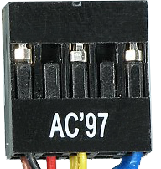
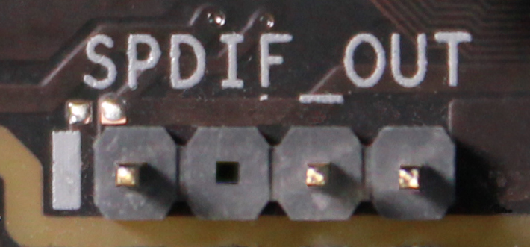
Plug Color Coding
Stereo audio line-in signal supplied by most devices, e.g. CD players (Light blue)
Stereo audio out or line-out. Suitable for speakers/headphones/front speakers (Lime)
Mono microphone in (Pink)
Audio out for rear speakers in surround sound system (Black)
Audio out for subwoofer in surround sound system (Orange)
Audio out for side speakers in 7.1 surround sound system (Gray)
TOSLINK (Fiber)
AC’97
S/PDIF
HD Audio
HDMI
ITFreeTraining.com
© Copyright 2023
Notes:
03:56 Plugging in the speakers should not be too difficult. If your computer has 3.5mm audio plugs, they should be color coded so you know which ones to plug in. It is just a matter of matching them up with your surround sound system. 5.1 surround sound will require three plugs. 7.1, which I will look at later in the video, will require four plugs. A lot of the new surround sounds systems will use blue tooth. If your computer does not support blue tooth, you can purchase a blue tooth adapter.
Many motherboards and surround sound systems will also support TOSLINK. TOSLINK is a fiber cable that will carry multiple audio signals. Since there is only one cable, it can only transmit in one direction, thus no return channel. This is why, on the computer, you will always see this enabled by default, as there is no return channel. This means there is no way for the computer to know if it is plugged in on the other side. By contrast, if you are using 3.5mm audio plugs, the computer can detect when something is plugged in on the other side.
Your motherboard may also have S/PDIF connectors. These connectors are found on the motherboard. These connectors are capable of carrying a surround sound signal. Also, on the motherboard you may have an AC’97 connector or an HD Audio connector. These are capable of carrying surround sound signals. In some cases, the easiest way to use one of these connectors is to plug them into a front panel audio module. A front panel audio module is installed in the front of the computer case and generally has a number of 3.5mm plugs on it that will allow you to plug in your surround sound system.
I will also mention HDMI. HDMI is capable of carrying surround sound; however, generally when it is used, it will be plugged into a monitor which will only support stereo sound. Monitors generally don’t have an audio out and, if they do, it is generally only stereo. For surround sound to be supported in HDMI, it will generally be plugged into devices like sound bars. Sound bars, like the name suggests, are essentially long bar-like speakers that sit under the screen. Other speakers can be connected to the sound bar for surround sound.
Although technically you could use a sound bar with a computer, generally people just purchase surround systems designed for use with a computer. However, if you have it lying around, you might as well give it a go.
Now that we have our surround sound system plugged in, let’s have a look at how to test if it is working. To do that, I will change to my computer running Windows 10.

Slide 4
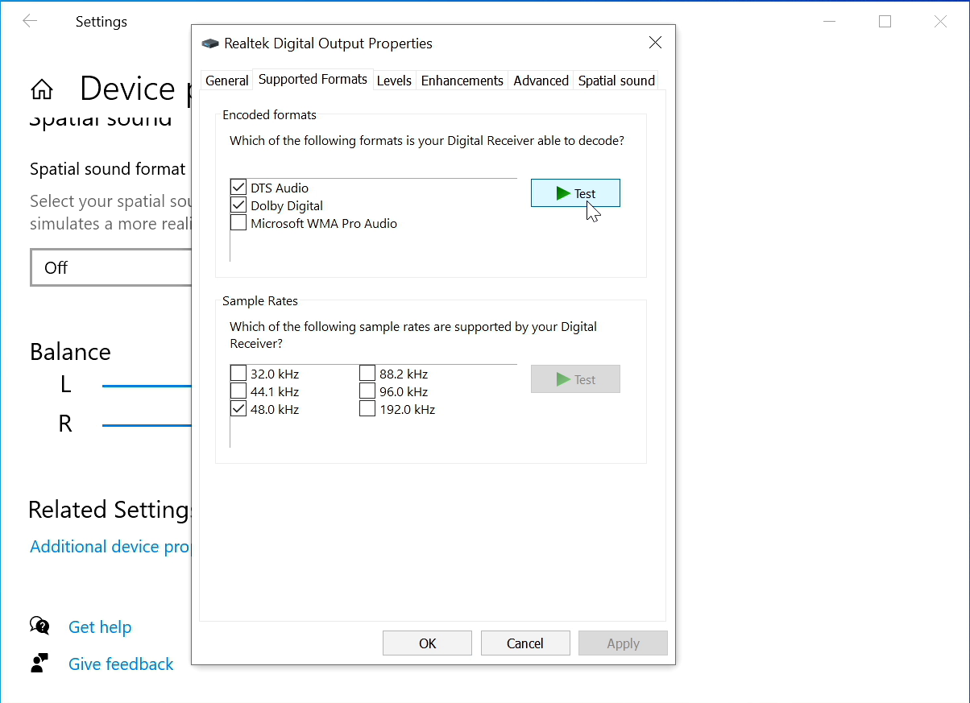
Demonstration
ITFreeTraining.com
© Copyright 2023
Notes:
06:52 To test our system and make sure that 5.1 surround sound is working, I will go to the sys tray and right click on the speaker icon and select the option “Open Sound settings”. This will show the settings for all the sound systems installed on the computer. In this case, the sound device that I want to look at is already selected. If your sound adapter is not selected, you will need to select it from the top pull down.
To access the settings for the sound adapter, I will select the option “Device properties”. This will show some of the basic settings; however, I want to see some of the more advanced settings. To open the advanced settings, I will scroll down and select the option “Additional device properties”.
You can see, on the first window, this will display some information about the jack. In this case, the jack that is connected is the rear panel optical jack. If you are using 3.5mm audio plugs, it is good to check this as if only one plug is showing then the computer is only outputting stereo. To get it to output surround sound you may need to change a setting or check that your audio plugs are plugged in correctly.
The next tab is “Supported Formats”. This tab shows which formats Windows thinks are supported by your surround sound system, and thus will attempt to send these signals. Keep in mind that I am using a fiber connection, so Windows won’t get any feedback that it is working.
You will notice that there is “DTS Audio”, “Dolby Digital” and “Microsoft WMA Pro Audio” listed. Later in the video I will have a look at these standards, but for the moment you just need to understand that these are different encoding standards. That is, they determine how the sound will be encoded before it is transmitted.
The next important part is to test that the sound is working. So, I will select “DTS Audio” and press “Test”.
The first sound was the subwoofer being tested. After this, each speaker is tested, and you can hear each speaker is given a slightly different sound. The order is subwoofer, front left, center, front right, rear right and finally rear left. Essentially after the subwoofer is tested each speaker will be tested in a circle. If you find that the order is not right, then you have connected a speaker up incorrectly and you will need to unplug that speaker and plug it in correctly. Depending on what audio adapter your computer is using, the manufacturer may supply other software to help configure and test your audio adapter. This software is generally easier to use than what Windows provides, and may contain additional settings to configure your sound adapter.
Now that I know that my sound is configured correctly, I will press “Yes”. Under the encoding format are the sample rates. You are free to choose the sample rates that you want. You can see the default is 48 kHz. This is the sample rate that is used for DVDs. Humans are not able to hear differences in sounds after 20 kHz. In order to digitize a sound signal, it is best to double the rate in order to ensure you capture all the sound signals that a human can hear. This prevents problems with rounding errors and other issues capturing the signal. This would give you a rate of 40 kHz; however, to get around some other capturing issues, a little extra is added to give a little wiggle room so to speak.
So, you can understand where the rate of 48 kHz came from. This is a standard for DVDs, audio and video recording devices. 44.1 kHz was the standard for CDs, so you will generally find that a lot of devices will support at least these two.
Since the human ear does not hear above 20 kHz, for the end user it is not worth using the higher sampling rates. These rates are generally used in audio production where they can be quite useful. For example, if you want to record something and then slow it down, the higher rate is quite useful. If you are not planning on recording your output and then doing audio production on it, I would recommend leaving it on 44.1 and 48 kHz settings. This will give you good audio sound and is well supported by other devices. As before, you can test the sample rate to make sure it works by pressing the “Test” button.
Essentially, what occurs is the software on the computer will request a particular encoding format and sample rate. Your sound system will need to support that encoding configuration. If, for example, your sound system only supports Dolby Digital and the media is encoded with DTS Audio, the sound system will not be able to play it. If the encoding is not supported, most likely the sound will be played using stereo. Stereo is only two channels and thus you lose all the extra benefits of having surround sound.
Sample rate is not such a problem, because the computer can always upscale or downscale as required. However, the encoding cannot be changed as easily, so the sound system you use needs to support the required encoding. Let’s have a closer look.

Slide 5
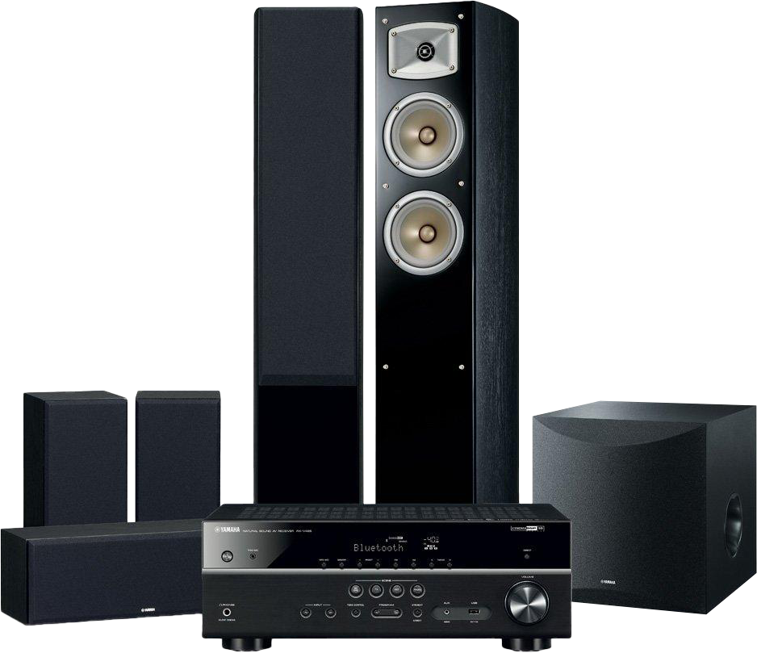
Encoding Formats (5.1)
Standardized/Efficient transfer of data
AV Receiver needs to support encoding format
Audio Video (AV) Receiver
448 Kbps DVD/640 Kbps Blu-ray
Claims better compression
1.5 Mbps
ITFreeTraining.com
© Copyright 2023
Notes:
12:30 An encoding format is essentially a standardized efficient way to transfer data from the device to the receiver. For those of us who were around in the 80’s, you may remember before a movie hearing this sound.
This is the sound that only certified THX cinema is allowed to play before a movie to indicate it is THX certified. THX is an American company. THX is not a recording technology, but rather a quality assurance system for audio. The idea being that if a cinema or home system meets this standard then it supports a playback environment that would give as close as possible sound as the original mixing engineer intended.
To use surround sound, you simply need to ensure that the media you are using is supported by the Audio Video Receiver or AV receiver that you are using. The 80’s saw a lot of competing standards for audio. Some were created but never used. Others have disappeared from the market completely. It is up to the creator of the media to decide which encoding format that they want to use. A lot of AV receivers will support multiple encoding formats.
The good news is there were two clear winners from all that competition that most media uses today. These are Dolby Digital and Digital Theater Systems or DTS. There have been a few different versions of these standards and some name changes; however, you will generally see these logos (or something similar) on media that supports them. For example, on the back of a DVD or Blu-ray, you will see the logo indicating what encoding system was used to encode the audio.
Dolby Digital encoding is 448 Kbps for DVD and 640 Kbps for Blu-ray. While DTS has an encoding of 1.5 Mbps. Even though DTS has twice the bandwidth, Dolby claimed that they had better compression and thus the standard was as good as DTS.
Both give good sound for 5.1 surround sound. Dolby was in use before DTS, but DTS got its big break when it was used in Jurassic Park back in 1993. Nowadays, both are still widely used and give good results.
You should now have a good understanding of how 5.1 surround sound works, so let’s now consider another popular surround system, 7.1.

Slide 6
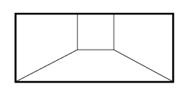
7.1 Surround Sound
7 speakers
1 subwoofer
Sub
Can be placed
anywhere in room
* Most systems will
support 5.1
ITFreeTraining.com
© Copyright 2023
Notes:
15:25 Surround sound 7.1, if you have not guessed, uses seven speakers and one subwoofer. As before, the subwoofer can be placed anywhere in the room. There are also other surround systems that were developed, for example 11.1 which uses 11 speakers and one subwoofer. These other systems were either never released or only used in theatres.
Before I look at what is different about surround sound 7.1, I will first look at what it has in common with 5.1 surround sound. You still have a sweet spot. When the person listening to the sound is in the sweet spot this is where they will hear the best sound.
Like 5.1, 7.1 has two front speakers and one center speaker. So far nothing has changed. Next there is a left and right speaker just likebefore. With 7.1, the speakers can be put between 90 degrees from the center to 110 degrees. So essentially, this means that if you have speakers from your 5.1 surround sound system, you won’t need to move them if you upgrade to a 7.1 system.
Next, there are two additional speakers added at the back. These need to be placed between 135 and 150 degrees from the center to get the best results.
If you decide to purchase a 7.1 surround sound system, most 7.1 surround sound systems will also support 5.1 surround sound. Essentially the rear left and right channels on the 5.1 system get mixed with the extra two speakers. If you are trying to play a 7.1 surround video on a 5.1 surround system, the codec used to decode the video will most likely mix both the rear channels left and right together. So, you should not have any compatibility problems.
In the real world, 5.1 surround systems are very common and you will find a lot of support for them. New movies are also starting to support 7.1 surround sound. If you do decide to go and purchase 7.1, you will pay a bit more for the extra two speakers. Will it be worth it? Either way you will get good sound. There are other sound systems that are coming up that may make you think a bit more about your decision, something I will look at later in the video. Before I do that, I will first have a look at some of the software available to help you set up your surround sound system.

Slide 7
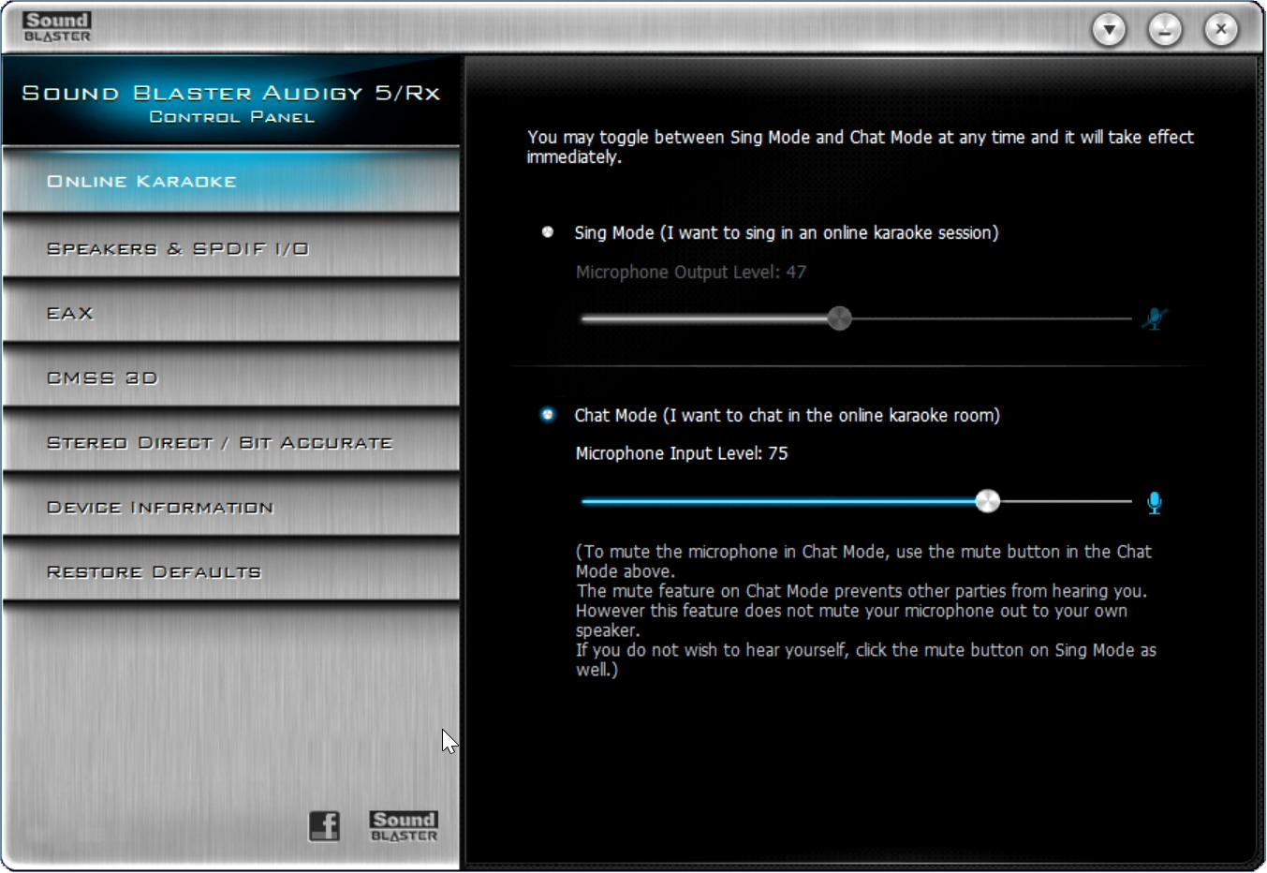
Demonstration
Sound Blaster Audigy RX
ITFreeTraining.com
© Copyright 2023
Notes:
18:06 This computer has a Sound Blaster Audigy RX card installed. Depending on what sound adapter you are using, there may be additional software on the computer which allows you to do additional configuration. Your audio receiver may also have additional options.
To have a look at these settings, I will open the Sound Blaster control panel. On the first screen, you will notice that there are some settings for Karaoke. If you are the singing type, you can use the Karaoke software supplied by Creative.
The next option down configures the speakers. You want to configure this to match the speakers that you are using. In this case I will configure it for 7.1.
The next option down is EAX. This stands for Environmental Audio Extensions. Essentially this setting changes the processing of the sound. The end result is that you can make it sound like you are in a certain location. For example, you can change the output so it sounds like you are in a living room or you could change it to be like sitting in an Opera House. Your AV receiver may also have settings like these. It is possible to change it on both the computer and the AV receiver, but I would recommend only changing them in one location.
The next option is CMSS 3D. This is a proprietary feature of Creative Labs so you may not be able to get driver support for other operating systems like Linux. This feature essentially takes a stereo signal and upscales it to 5.1 or 7.1 surround sound. This feature helps to get some use out of your surround sound system, even when the input is not designed for surround sound. This produces some o.k. results; however, not as good as sound created with surround sound in mind. You will notice that there is an option for “Stereo Surround”. CMSS is a Creative Labs solution and stereo surround is used by other manufacturers.
The next option is “Stereo Direct/Bit Accurate”. When this option is enabled, the sound data will be outputted directly to the surround sound system without additional processing. So essentially, this will send data to the AV receiver bit for bit from the original format.
That’s it for the Sound Blaster. It is not a bad idea to have a look through the extra software included with your sound adapter. There may be some good options in there that will give you a better sound experience.
There have been a lot of surround systems developed with some in use and some never adopted. There is a surround system 22.2 which as the name suggests uses 24 speakers. The problem with these systems is the media needs to be encoded for these systems to use them effectively. Wouldn’t it be good if we had a system that could take advantage of any number of speakers rather than be encoded with one system in mind? Fortunately, there are surround systems that do just this.
For Atoms let’s use this pronucation. https://www.youtube.com/watch?v=91BUM3WhCfo

Slide 8
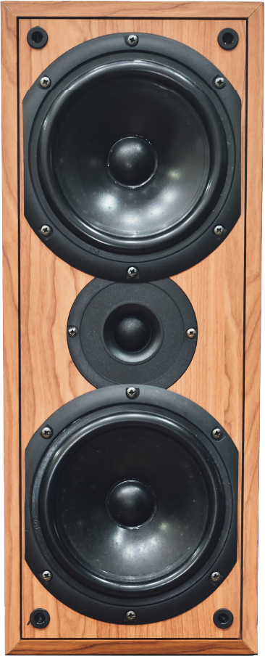
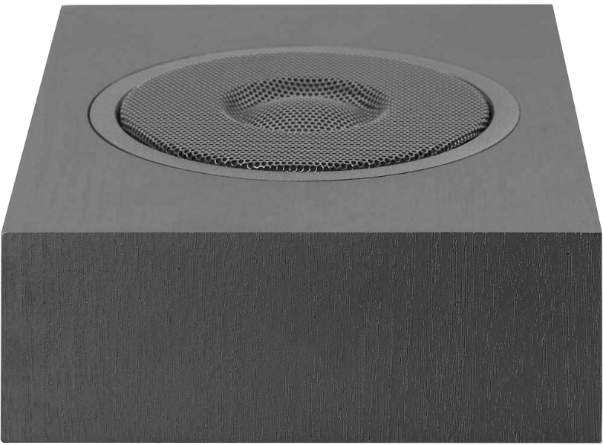
Dolby Atmos/DTS-X
Uses sound objects rather than channels
Supports roof/ground speakers
ITFreeTraining.com
© Copyright 2023
Notes:
21:11 There are two surround sound systems that look like, in the future, they will get some market adoption. These two systems, Dolby Atmos and DTS-X, are already getting supported on some new Blu-ray titles. These systems use sound objects rather than channels to produce sounds. To understand how this works, let’s consider an example.
Let’s say that you have a plane traveling from one side of the movie scene to the other with reference to the person watching the movie. To start with, let’s consider that we only have two speakers. As the plane moves, the volume from the speakers will change as the plane goes from right to left.
Considering that we have had stereo speakers for a long time, this is not that impressive so far. But let’s add two more speakers. When the plane moves right to left a second time, the volume of the sound made by the plane is adjusted for all four speakers. This is done in the encoder by working out where the plane is with reference to the number of speakers. The same data is used regardless of whether two or four speakers are used. It is not like other surround sound systems where you encode the audio with a particular number of speakers in mind.
Since the sound data is encoded as objects rather than channels, it also supports height. Thus, it supports roof and ground speakers. So essentially the system scales and accommodates your system depending on your speaker setup. Let’s consider another example to understand how this works.

Slide 9
Object-Based Audio Example
Screen
ITFreeTraining.com
© Copyright 2023
Notes:
22:51 Let’s consider that you are in a movie theater. At the front of the movie theater is a screen. In front of the screen and next to the walls are a number of speakers. You can see that we have scaled up from our four speakers to 12 speakers.
Let’s consider our plane is traveling from the back of the theater to the front of the theater. As the plane moves from the back to the front, the volume for each speaker is adjusted to suit.
Systems like this scale based on how many speakers you have and their position. In the case of Dolby Atmos it can handle 128 objects at once, whereas DTS-X can handle an unlimited number of objects. Both standards are good and it is up to the creator of the media to decide which they will support. It is becoming more common for AV receivers to support both; however, if you buy a new AV receiver, it is best to check.

Slide 10
In The Real World
5.1 is widely supported
7.1 not as much support. 7.1 should work with 5.1
New AV receivers may support Dolby Atmos/DTS-X
Future proof (I hope) if it supports both
ITFreeTraining.com
© Copyright 2023
Notes:
23:50 In the real world, you will find that 5.1 surround sound is widely supported and 7.1 not so much. On 7.1 surround sound systems 5.1 media should still work. The software playing the media should convert 7.1 to 5.1.
New AV receivers may support Dolby Atmos and DTS-X; however, don’t assume they do. If I purchase a new AV receiver, I would check to future proof it. It looks like either Dolby Atmos or DTS-X or both are the future. If you purchase a system that supports both of these, you should be set for at least a while to come. Who knows, they may come up with something better that will replace both of them, but at least for the moment one or both of them are the future.

Slide 11
Subscribe
Next video
Video content: https://ITFreeTraining.com/ap/2c30
© Copyright 2023
Notes:
24:43 That concludes this video from ITFreeTraining on surround sound. If you decide to purchase a surround sound system, I wish you luck with your purchase. There are a lot of good systems out there. Until the next video from us, I would like to thank you for watching.
References
“The Official CompTIA A+ Core Study Guide (Exam 220-1001)” Chapter 5 Paragraph 202 - 210
“CompTIA A+ Certification exam guide. Tenth edition” Pages 420 -421
“Surround sound” https://en.wikipedia.org/wiki/Surround_sound
“5.1 surround sound” https://en.wikipedia.org/wiki/5.1_surround_sound
“7.1 surround sound” https://en.wikipedia.org/wiki/7.1_surround_sound
“Understanding Surround Formats in AV Receivers” https://www.youtube.com/watch?v=DFmhbNAUcrs
“44,100 Hz” https://en.wikipedia.org/wiki/44,100_Hz
“Dolby Atmos” https://en.wikipedia.org/wiki/Dolby_Atmos
“DTS (sound system)” https://en.wikipedia.org/wiki/DTS_(sound_system)
“Picture: Cat lying down” https://unsplash.com/photos/fZ8uf_L52wg
“Picture: 5.1 Surround sound” https://upload.wikimedia.org/wikipedia/commons/d/d7/5-1-surround-sound.svg
“Picture: Biplane” https://unsplash.com/photos/Eu1xLlWuTWY
“Picture: Speaker” https://unsplash.com/photos/0vO0z83M4bc
Credits
Trainer: Austin Mason http://ITFreeTraining.com
Voice Talent: Tomislav Krevzelj
Quality Assurance: Brett Batson http://www.pbb-proofreading.uk

