Slide 1
Notes:
In this video from ITFreeTraining, I will look at audio connectors. Audio connectors provide a way to plug speakers and other audio devices into the computer. This video will look at what you need to know about audio connectors so that you can use them effectively.

Slide 2
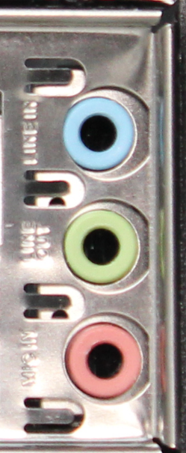
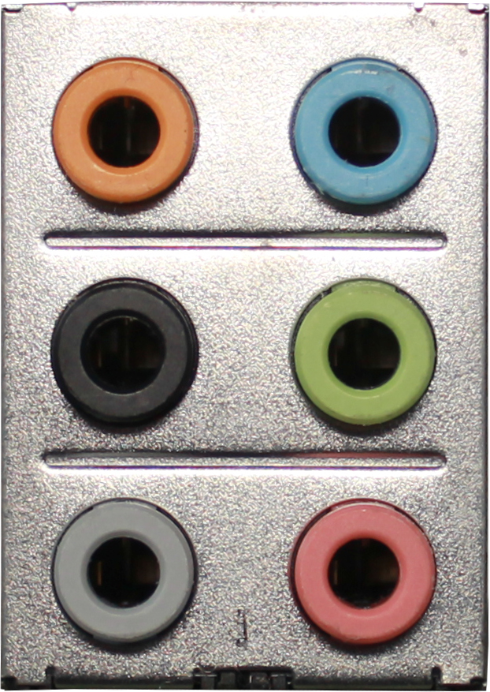
Audio Jacks
Uses 3.5 mm (1/8 inch) TRS plugs
Sleeve
Three jacks
Five jacks
Six jacks
Ring
Tip
Stereo audio line-in signal supplied by most devices e.g, CD players (Light blue)
Stereo audio out or line-out. Suitable for speakers/headphones/front speakers (Lime)
Mono microphone in (Pink)
Audio out for rear speakers in surround sound system (Black)
Audio out for subwoofer in surround sound system (Orange)
Audio out for side speakers in 7.1 surround sound system (Gray)
ITFreeTraining.com
© Copyright 2023
Notes:
00:16 To start with, I will look at the audio jacks. Pretty much all computers have audio jacks on the back of the computer in the IO Panel. These jacks are 3.5 millimeter or 1/8-inch TRS plugs. Essentially the connector is a metal cylinder which is divided up by insulation into different parts. With audio, the cylinder is broken into three parts which are called the Tip, Ring and Sleeve, thus the name TRS.
Different computers will have a different number of audio jacks. In many cases there may be three, five or six. To make it simple to know which plugs are which, they are color coded. Unless you have surround sound, you will most likely only use three of the plugs at the most.
The light blue plug is used for input from a device, often called line-in. A lot of devices like CD players will have an output jack that is compatible with the line-in jack. It is quite a common connection and is found in a lot of sound and video systems.
The lime color plug is for audio out. This can be used for headphones, speakers or output to another device. The pink plug is the microphone plug. This is an input plug just like the line-in plug, however it is mono. The other difference is that the voltage levels are different. This is important to know because if you plug a microphone into the line-in or vice versa the audio will get distorted. If you find the audio is distorted or contains a ringing noise, you may have it plugged into the wrong plug.
The black, orange and gray plugs are all for surround sound. If you have a surround sound system, you will need to plug the speakers into the correct plugs. For example, the subwoofer is the orange plug. In most operating systems there will be a way to test the sound, so you will be able to test each speaker to make sure that it is plugged into the right connector.

Slide 3
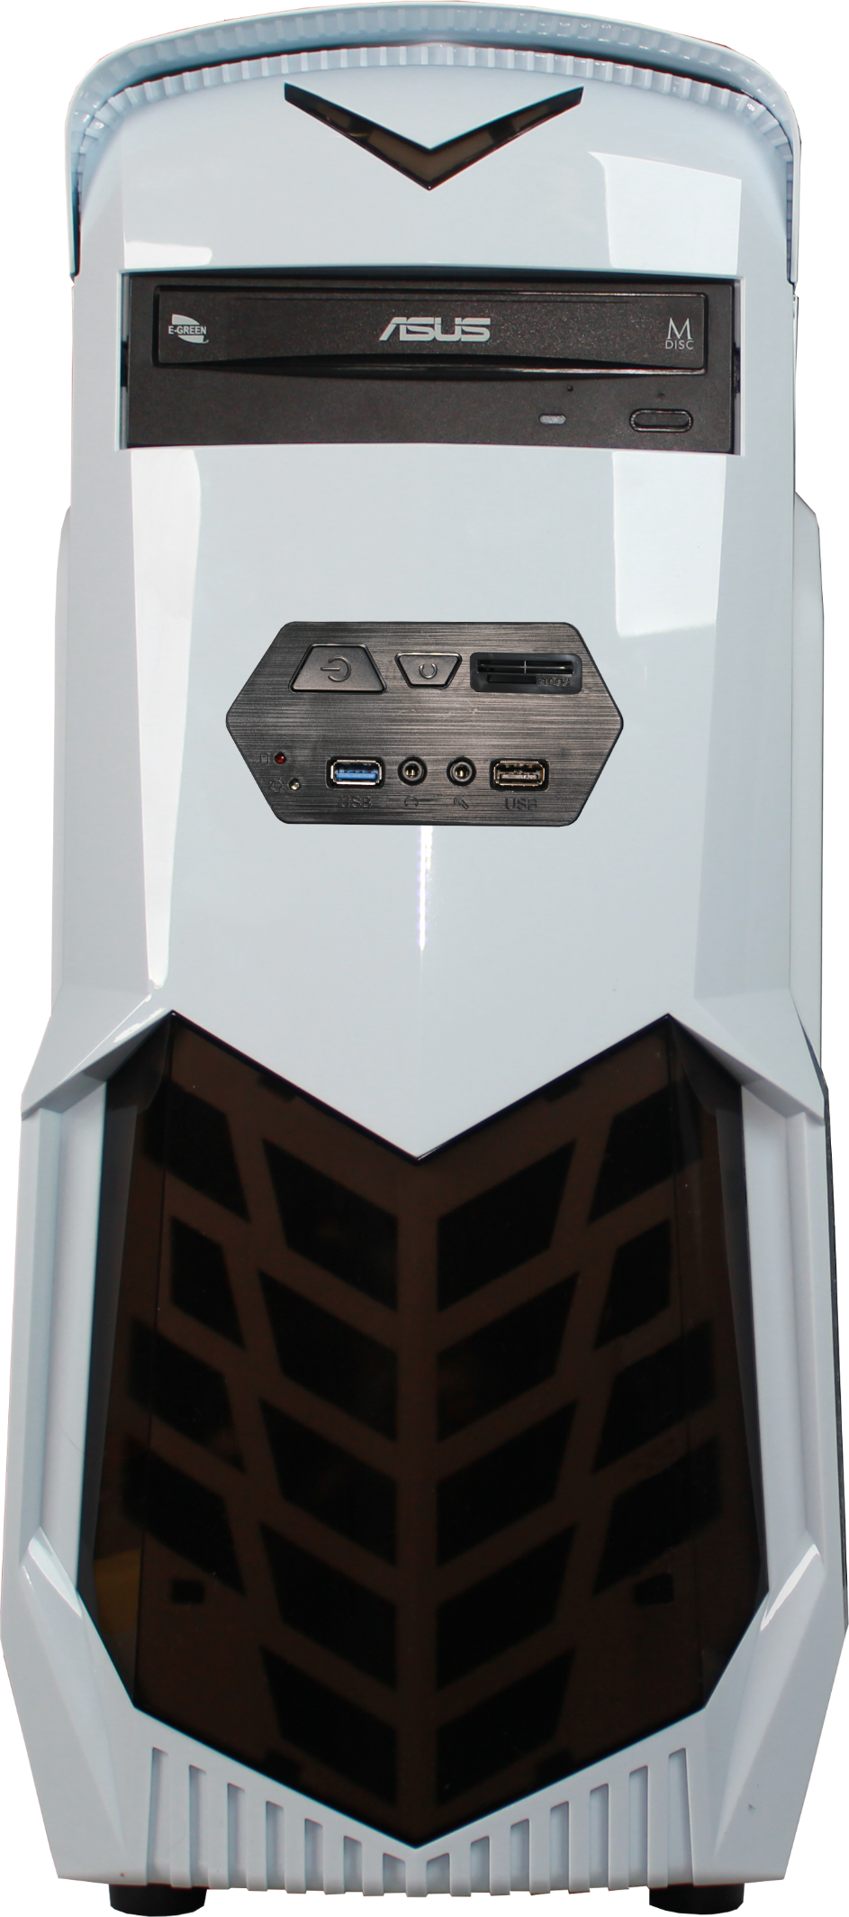
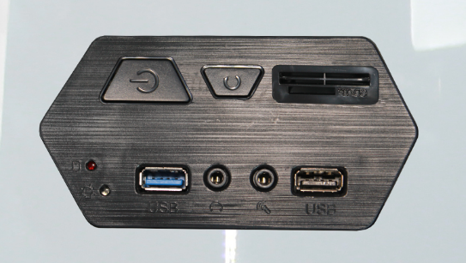
Front Panel Connectors
Usually on the front or top at the front
Headphone and Microphone jack
ITFreeTraining.com
© Copyright 2023
Notes:
02:18 On a lot of computer cases, there will be additional audio jacks. These are usually found on the front of the case or on top, however in some cases may be on the side. In this example, the additional audio jacks are on the front of the computer case. There will generally be two audio jacks; one is a headphone jack and one is the audio jack. These jacks may be colored, however there is no guarantee this will be the case. The jacks in the IO shield will most likely be colored.
Depending on your motherboard, there may also be a fiber or ARC audio connectors. Let’s have a look.

Slide 4
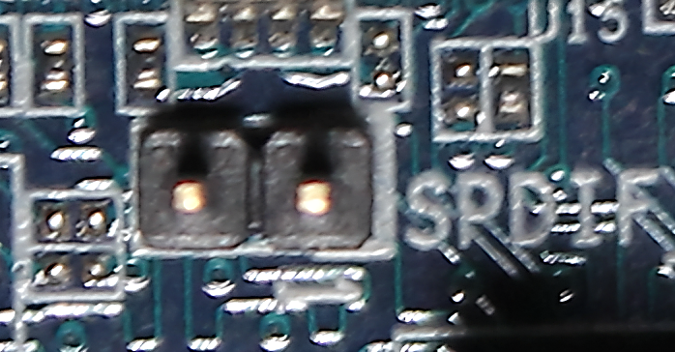
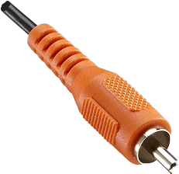
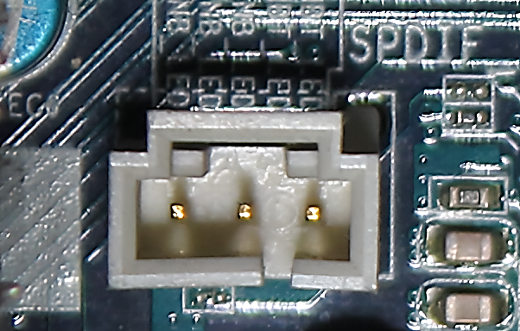
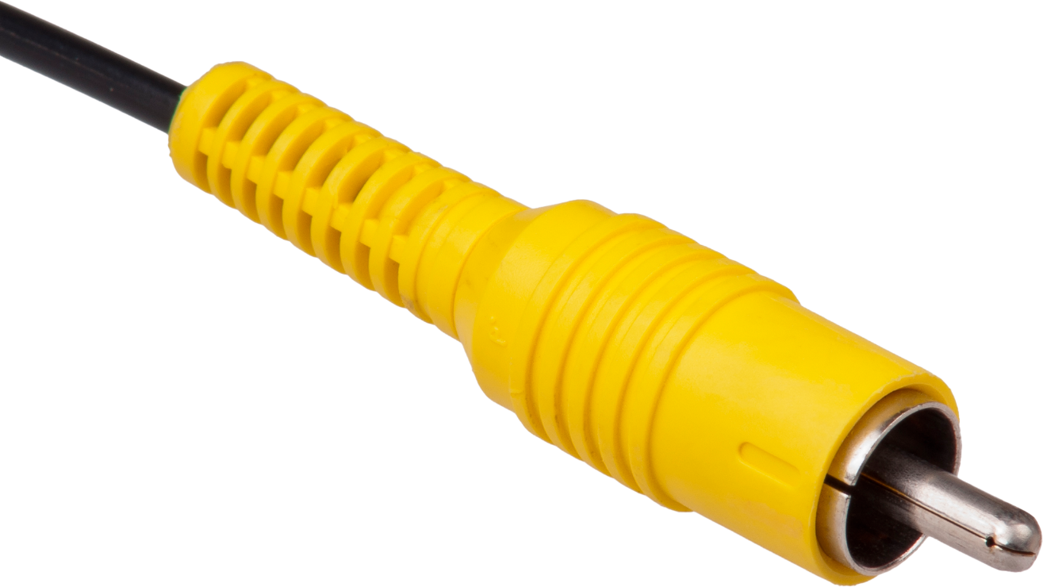
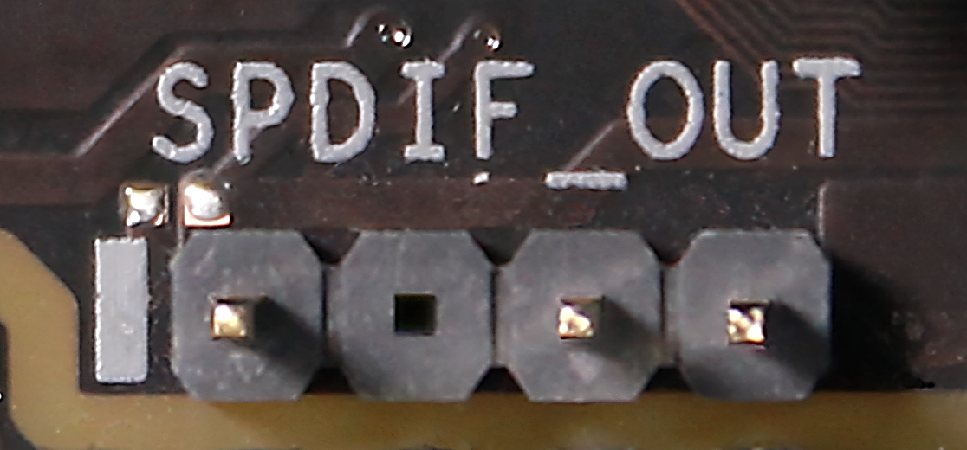
Sony/Philips Digital Interface (S/PDIF)
Supports
2 pin
2 audio channels
5.1 surround sound
7.1 surround sound
3 pin
4 pin
(3 used)
Fiber Cable (TOSLINK)
Motherboard Header
Coaxial Cable
Not subject to interference
On older motherboards
RCA Connectors
ITFreeTraining.com
© Copyright 2023
Notes:
02:56 The next connector that I will look at is the S/PDIF connection. This was originally created by Sony and Phillips and thus where the name comes from. The S/PDIF connection supports two audio channels, or 5.1 surround sound or 7.1 surround sound.
If you have an S/PDIF connection in the IO area of your computer, nowadays it will most likely be a fiber connection. The connection itself is called TOSLINK, named after the company that developed it Toshiba. In older computers, these may come with a coaxial cable rather than the fiber connection. Keep in mind the computer may not have either, as different motherboards will have different capabilities.
The coaxial cable has RCA connectors on the end. Keep in mind that even though there are two cables, S/PDIF only outputs data in one direction. It does not support bi-directional communication. If you do have this connection, in some cases the motherboard will only have one RCA plug. Since this is using a coaxial cable, the communication is subject to interference, whereas a fiber cable is not. Fiber, although not subject to interference, will break if you bend it too far. Coaxial cable, however, is a lot more flexible than fiber, so this can be useful in some cases.
If you do not have the S/PDIF connecter in the IO area of your motherboard, your motherboard may have a header on it for the connector. This connector is generally found on older motherboards and not so much on the newer motherboards. Nowadays, if the S/PDIF connection is supported, you most likely will find it in the IO area of the motherboard. If you have the connection, it may be a
four-pin plug, three-pin plug, two-pin plug or a combination of these.
If you plug the S/PDIF into another device, either using the fiber or the coaxial cable, the other device needs to support it. Both coaxial cable and fiber can carry a number of different signals. If you are plugging in a device like a surround sound system, there is a good chance it will support it; however, with specialized audio devices, you will need to check that it is supported.
Since a motherboard can have multiple different audio connections, these can all appear in the operating system as different devices, so let’s have a look.

Slide 5
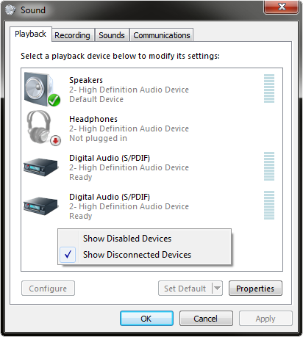
Device Connections
To make it easy, disable unused connections
Options to show Disabled/Disconnected devices
ITFreeTraining.com
© Copyright 2023
Notes:
05:22 In this example computer, there are five audio jacks and two S/PDIF connections, one in the IO area and one on the motherboard. When you start getting a lot of audio devices on the same computer, it can be difficult to determine which is the one you want to use. To make things easy, consider disabling any devices that you are not using. This particularly makes it easier for the general user. The general user will probably only use a couple of them, so get rid of the ones they will never use.
If you do this, the device will disappear and won’t appear in the operating system as an option. When troubleshooting, make sure you check to make sure the device has not been disabled or is currently disconnected. In Windows, if you right click on the window this will display a menu that allows you to display disabled and disconnected devices. This may not seem like too much of a problem, but let’s consider what it looks like when we have a system with a number of audio connections and start adding additional audio connections such as audio from a monitor. You can understand why you would want to hide disabled or disconnected devices, however having these devices being hidden makes troubleshooting harder.

Slide 6
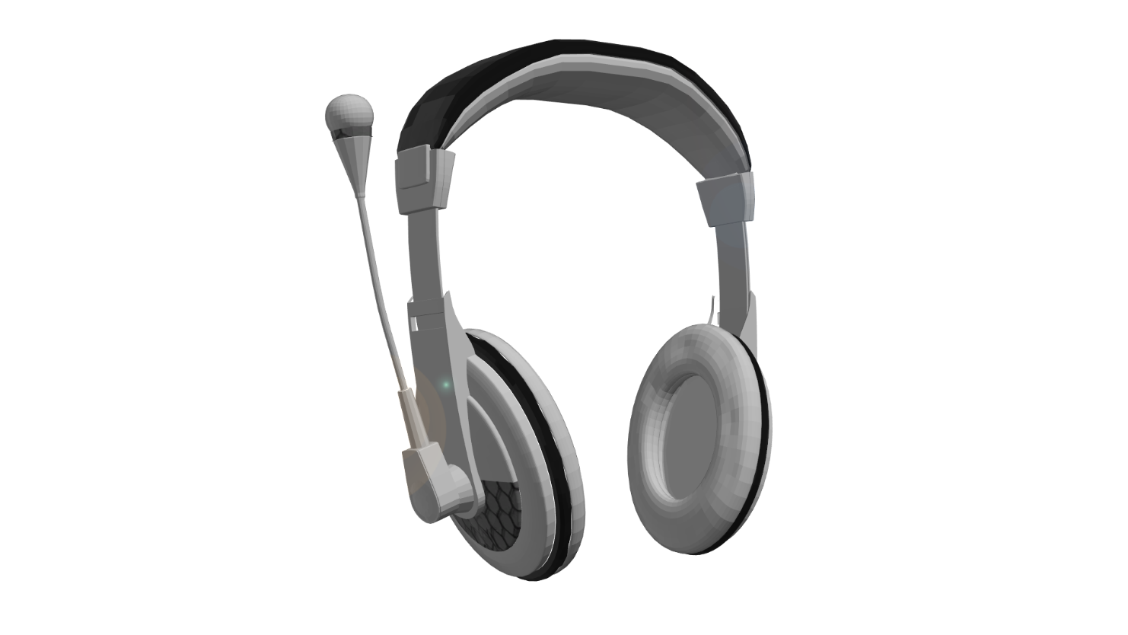
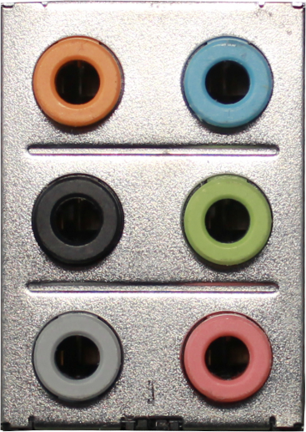
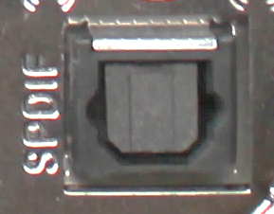
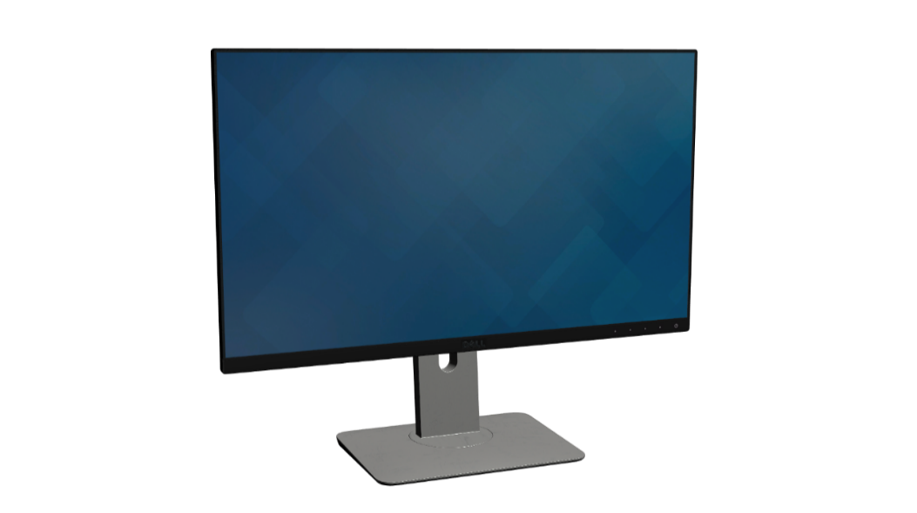
Monitor Audio
Some monitor cables support audio
Example setup
Five audio devices
ITFreeTraining.com
© Copyright 2023
Notes:
06:35 If you are using a TV as a display, it will have built-in speakers. Some monitors will also come with built-in speakers. In order to use these speakers, the cable connecting the computer and the monitor will need to support audio. DisplayPort, HDMI and Thunderbolt all support audio.
For sound to be supported, the video card will also need to support sound. Modern video cards should support sound, assuming the connection used supports it. This includes integrated video cards in a CPU. Older video cards may not have this feature.
You can start to see that a computer can easily support a lot of different sound adapters. If I consider a basic example: In a basic computer, you will have your audio jacks. Your computer may also have an S/PDIF connector. Next, let’s consider that a pair of USB headphones are plugged in. This will add an additional sound adapter. Lastly, let’s consider that two monitors are connected to the computer, that both support audio. This will now add two additional sound adapters to make a total of five audio devices.
You can see how quickly the number of audio devices on your computer can add up. In newer versions of Windows, it will hide devices that are disconnected, so if you don’t have anything plugged into the computer it will not be shown. The problem is that devices like monitors, even if you are not using the sound, will still appear as an available sound device. This can be confusing, so this is why I would recommend that, if you are never going to use it, you disable the device.
I will now have a look at how to configure an adapter that is plugged in.

Slide 7
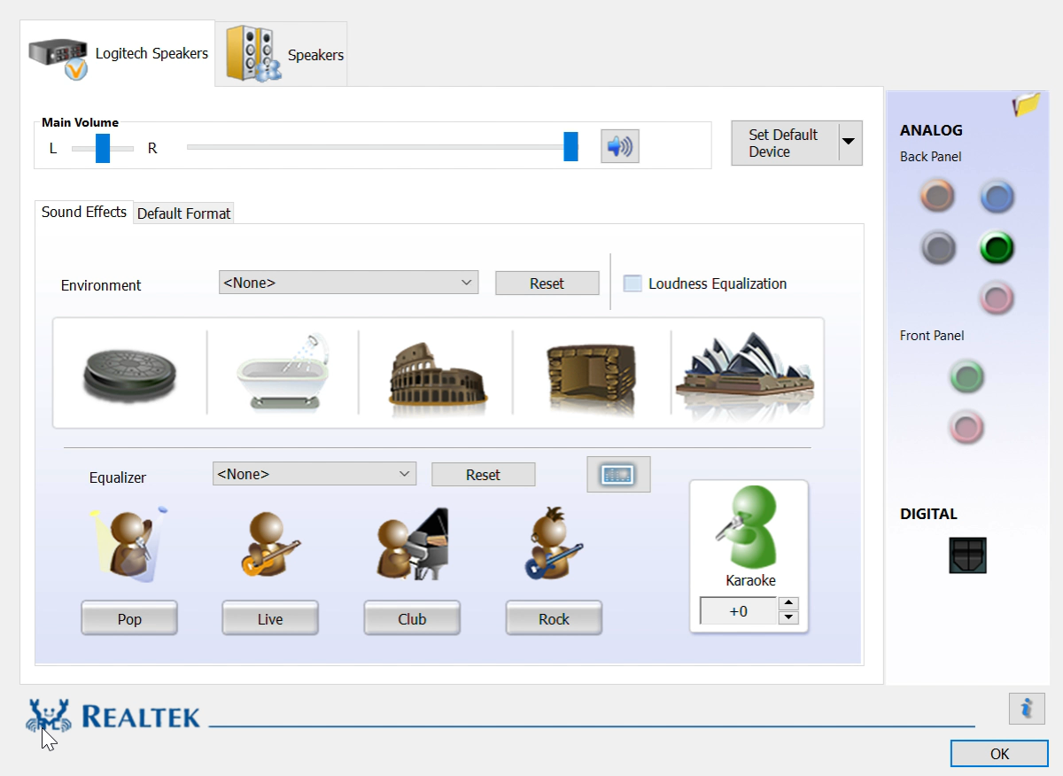
Configuration
Basic Windows/Advanced - vendor
Some adapters auto detect device plugged in
ITFreeTraining.com
© Copyright 2023
Notes:
08:23 To configure your adapter, Windows provides some basic configuration. This will be available through the control panel or by selecting the speaker icon in the sys tray. In some cases, the vendor may provide additional software to allow more advanced configuration. For example, RealTek often provides additional software to configure their sound adapters. This will be installed with the device driver, so if it is not present by default, it is recommended to download the device driver for the adapter and install it. The device driver that is supplied by Windows may not include this extra software.
To access the software, usually there will be an icon in the sys tray, otherwise you will be able to access it through the control panel or the start menu. For this particular adapter, the first screen will show information about the default sound adapter, in this case the S/PDIF adapter. On the right-hand side of the screen, notice that it will tell you what devices are currently plugged in.
In this case, the S/PDIF connector and audio jack are plugged in. If I select the audio icon, nothing will happen, as the sound adapter is already being displayed. Further up, notice that if I click the green jack, this will take me to the speaker tab.
In the audio jack is a headset. This has been detected as speakers which is technically correct. Depending on the software available, you may be able to change settings to affect how the sound is processed. For example, you may be able to configure the sound so it sounds like it is being played in a large hall.
In some cases, the sound adapter may have the ability to detect what device has been plugged into the audio jack, for example, if you plug in the headset into the line-in. This sound adapter does not have that ability. Using this, the adapter can internally change its wiring to treat the line-in as speakers. There are limits to what it can and can’t detect. If you are using a surround sound system, don’t expect the sound adapter to be able to detect the difference between regular speakers and a subwoofer. For this reason, I would always recommend plugging the device into the correct jack; however, if you can’t remember the colors then you can always take a guess, as you won’t break anything by trying.

Slide 8
Subscribe
Next video
Video content: https://ITFreeTraining.com/ap/2c20
© Copyright 2023
Notes:
10:42 I hope this video has cleared up any questions you had in relation to the audio connectors on your computer. Best of luck with your sound setup, and until the next video, I would like to thank you for watching.
References
“The Official CompTIA A+ Core Study Guide (Exam 220-1001)” Chapter 5 Position 191 - 203
“CompTIA A+ Certification exam guide. Tenth edition” Pages 420 - 422
“S/PDIF” https://en.wikipedia.org/wiki/S/PDIF
“Picture: Jackplug” https://commons.wikimedia.org/wiki/File:Jackplug-wiring.svg
“Picture: TOS LINK clear cable” https://commons.wikimedia.org/wiki/File:TOS_LINK_clear_cable.jpg
“Picture: Composite-video-cable Yellow” https://en.wikipedia.org/wiki/File:Composite-video-cable.jpg
“Picture: Digital coaxial audio cable (orange)” https://commons.wikimedia.org/wiki/File:Digital_coaxial_audio_cable_(orange).jpg
“Picture: DisplayPort” https://en.wikipedia.org/wiki/DisplayPort#/media/File:DisplayPort.svg
“Picture: High Definition Multimedia Interface Logo” https://commons.wikimedia.org/wiki/File:High_Definition_Multimedia_Interface_Logo.svg
“Picture: Thunderbolt” https://commons.wikimedia.org/wiki/File:Thunderbolt.svg
Credits
Trainer: Austin Mason http://ITFreeTraining.com
Voice Talent: HP Lewis http://hplewis.com
Quality Assurance: Brett Batson http://www.pbb-proofreading.uk

